Slide 1
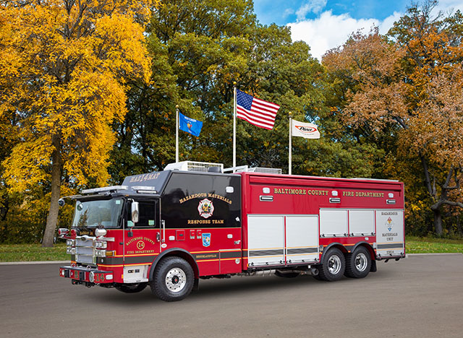

Slide 2
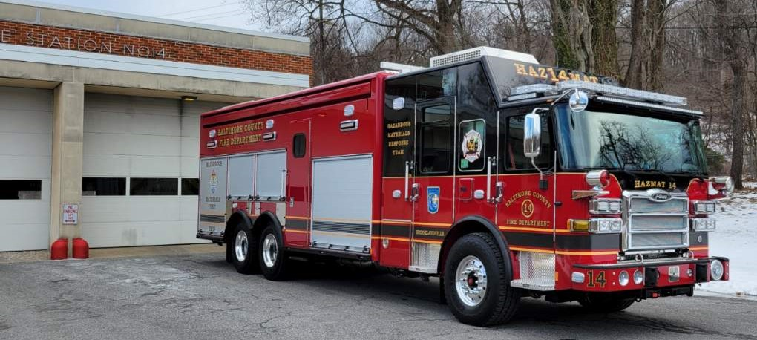
Pierce New Delivery Orientation

Slide 3


Welcome to
Orientation
Presented By:
Pierce New Delivery Trainer - Andy Barden
abarden@atlanticemergency.com

Slide 4

Objective:
Upon the completion of the Pierce New Delivery Orientation Program the operators will be able to identify components and safely operate the apparatus and it’s associated equipment.

Slide 5
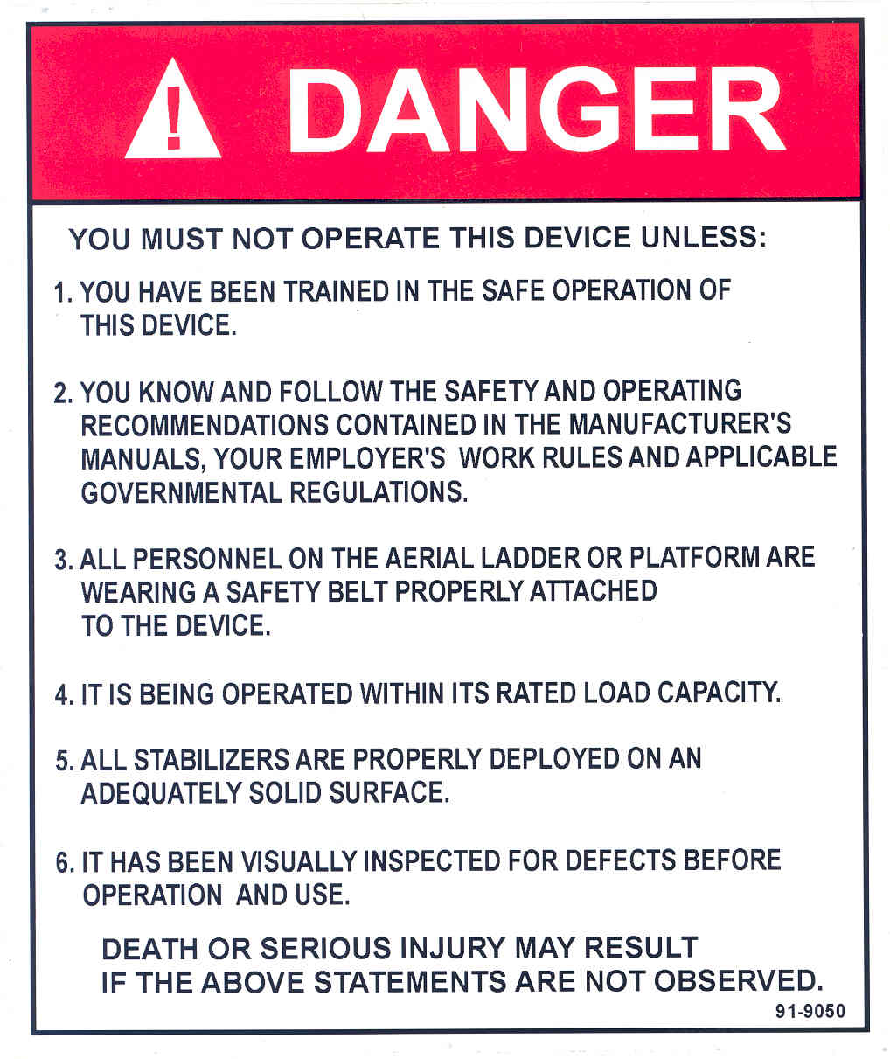
Operators
Only qualified operators will use this heavy rescue apparatus. All operators need to be familiar with the Operation and Maintenance Manual and need to have formal hands-on training!
Those who drive Haz Mat 14 will need
additional training!

Slide 6

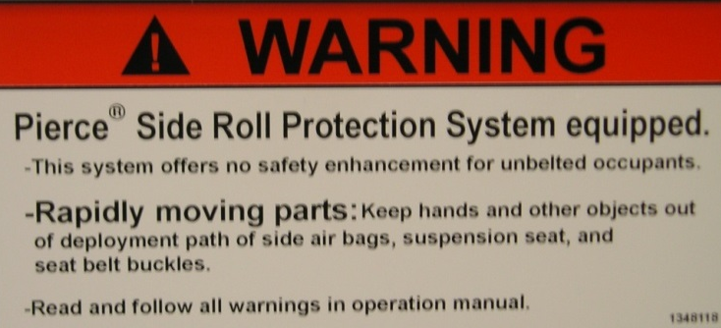

Safety, Tags, and Labels
Apparatus contains many labels
Read and understand
all labels before operating
Danger.
  Injury or death MAY occur.
Warning.
  Injury or death MAY occur.
Caution.
  Potential for equipment
  damage and minor injuries.

Slide 7
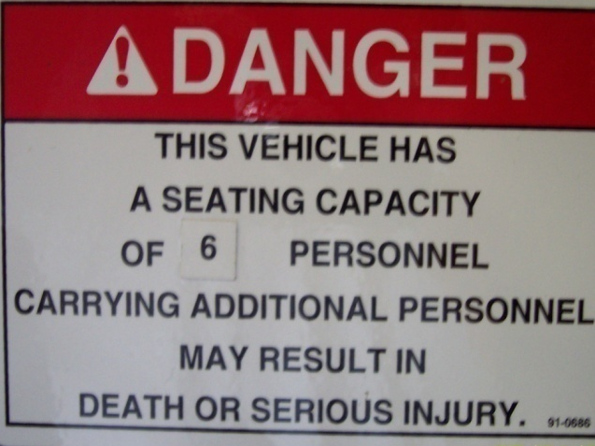

Safety
Refer to seating
Capacity label
Only seats with factory install belts should be occupied
Don’t ride on the vehicle outside of the cab
Back up camera with audible speaker
3

Slide 8
Vehicle Data Recorder (VDR)
Pierce apparatus are equipped with a Vehicle Data Recorder (VDR).
The VDR is capable of reading and storing the most recent 100 hours of vehicle information.
The vehicle data recorder can record the following: • Vehicle Speed - MPH
• Acceleration
• Deceleration
• Engine Speed - RPM
• Engine Throttle Position
• ABS Event
• Seat Occupied Status
• Seat Belt Buckled Status
• Master Optical Warning Device Switch
• Time
• Date * Governed to 60 MPH

Slide 9

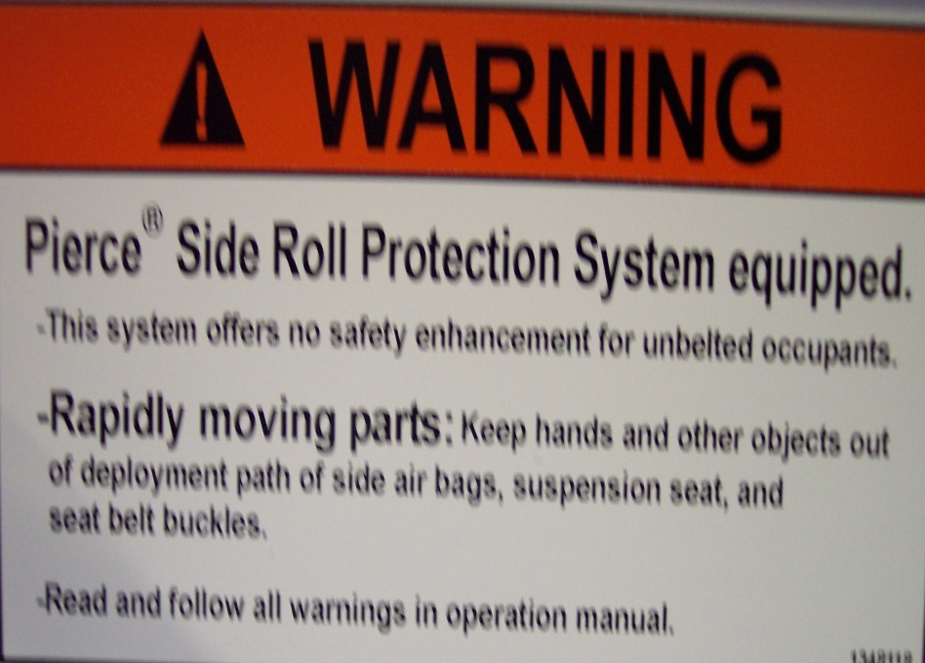
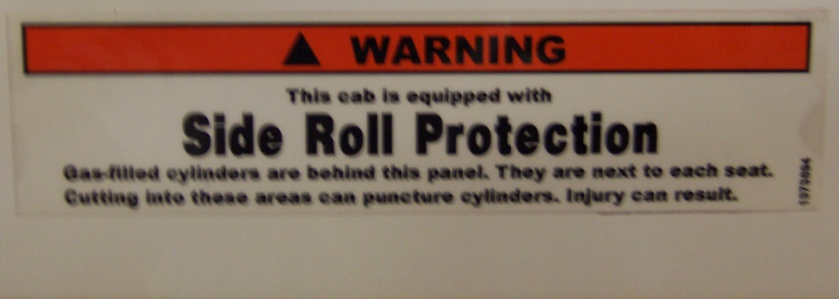
Side Roll and
Frontal Impact Protection
It is a supplemental
restraint system
Side roll will not operate
in all crashes
If system is activated,
must be repaired by Pierce

Slide 10


Slide 11
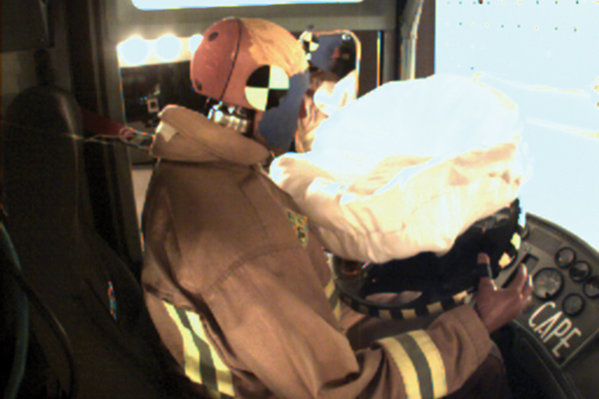

Slide 12
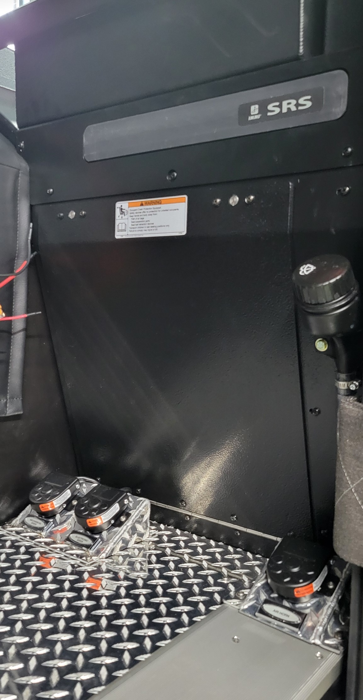
Knee Bolster Airbag – Officers side only
*Do not hang and place anything in front of airbag

Slide 13
Safety Equipment
ESC - Electronic Stability Control
ABS (Anti-lock brake system)
ATC – Automatic Traction Control
Auxiliary Braking systems
  Compression brake “Jacobs Brake”
  ON OFF HI MED LOW
  “If you have to adjust your driving for the road conditions, the Jake Brake should
  be turned off”
  257.5 ” wheelbase, length 39’ 8”

Slide 14
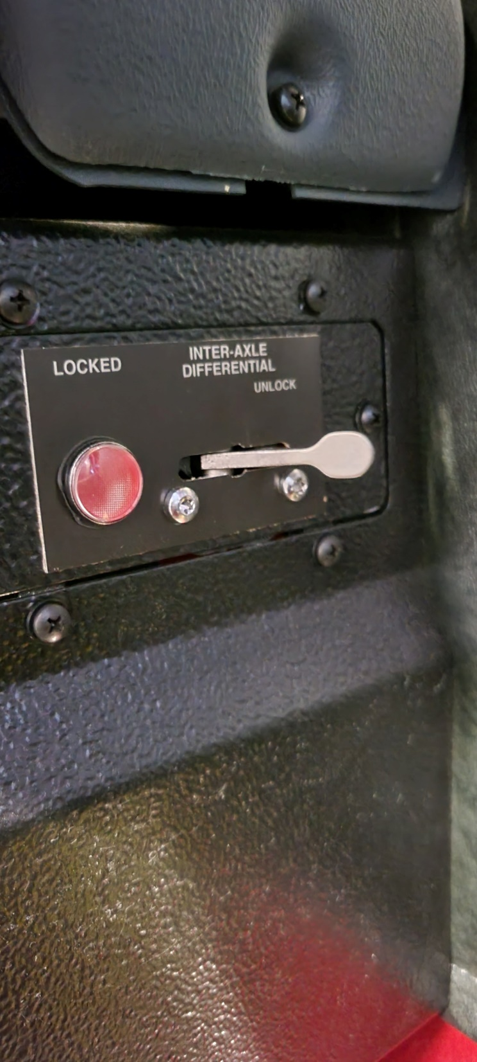
Inter-axle Differential lock

Slide 15
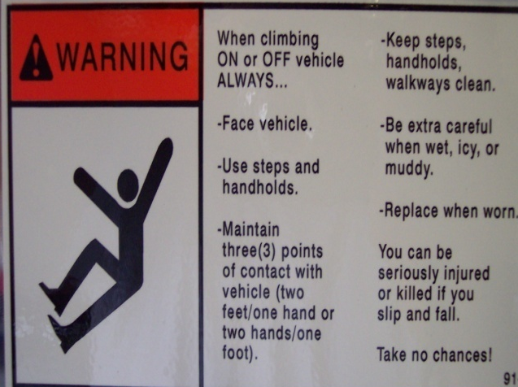

Safety Equipment
Hand and grab rails
Seat belts
  Alarm & Monitoring System
*Single Parking Brake Control- All wheel Lock-up

Slide 16
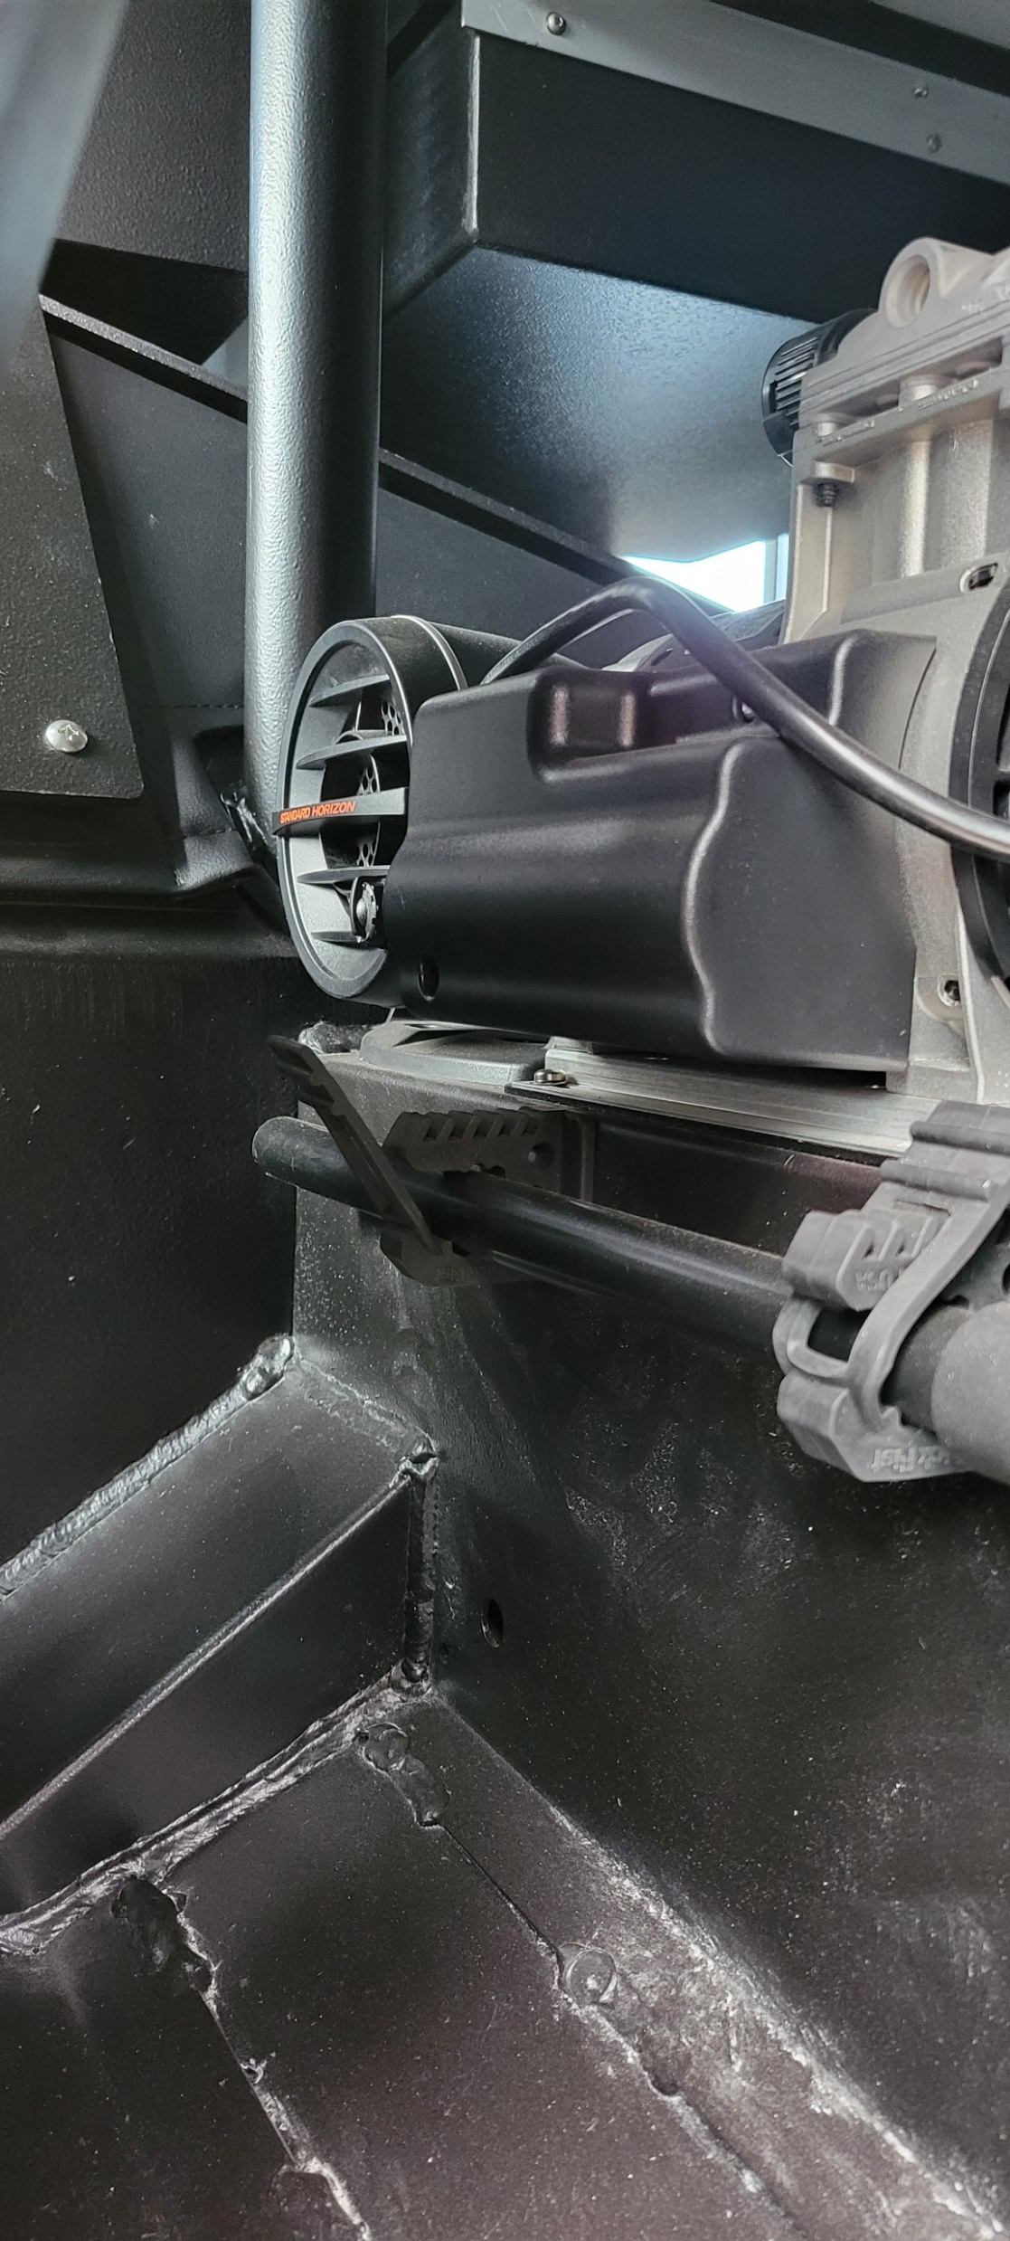

Slide 17
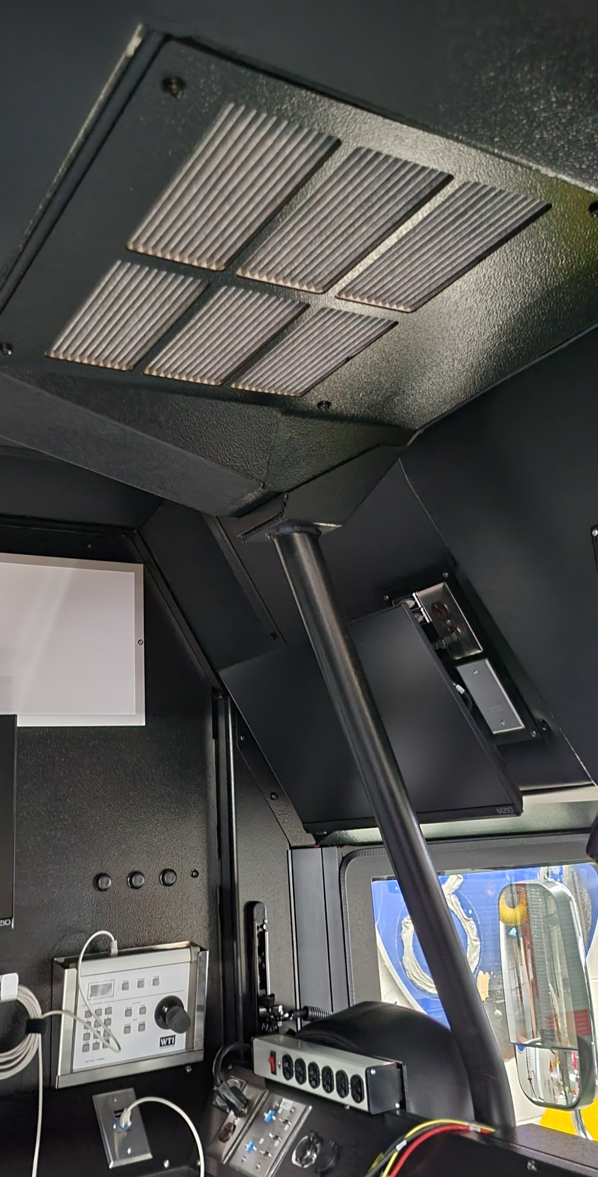
CARE
Carcinogen
Awareness &
Reduction to
Exposure
Clean Cab Initiative
HEPA filter

Slide 18

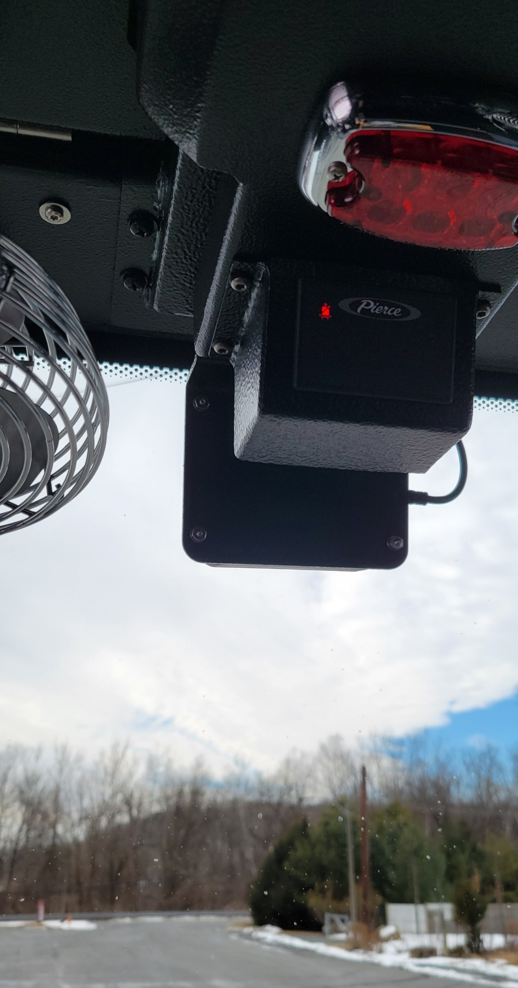
HAAS Alert Collision Mitigation
https://www.haasalert.com/
HAAS R2V

Slide 19
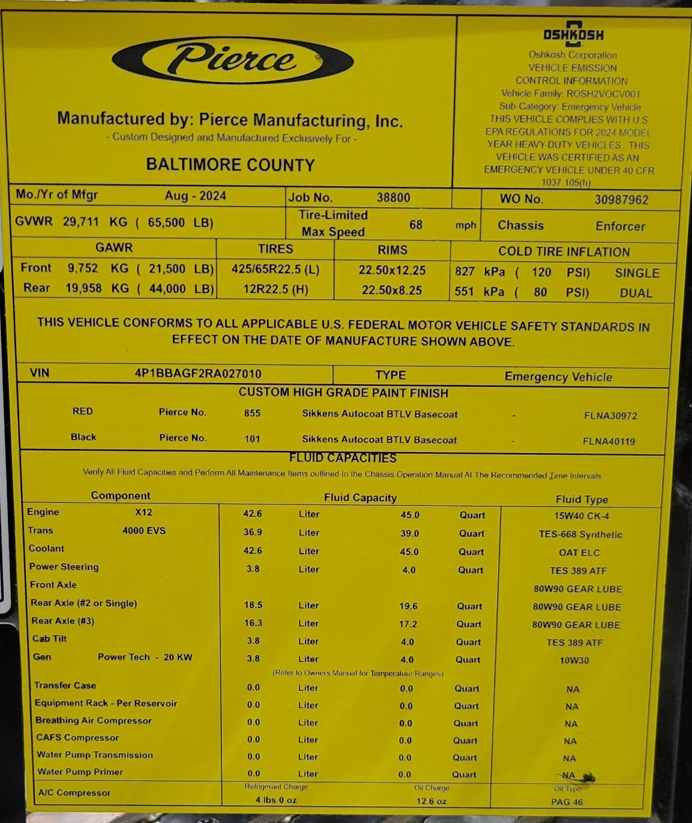
Vehicle Information Sticker

Slide 20
Customer Installed Equipment
Modifications
  Drilling holes or welding to structural frame components of the chassis is NOT permitted.
  Can be made to non-structural sheet metal.
    Contact Pierce.
  Consider dissimilar metals.
Mount all equipment to withstand road travel.
  Equipment mounting should comply with NFPA 1901
Follow “Radio Installation Guide.”
Welding instructions must be reviewed before welding on any Pierce Apparatus

Slide 21
Before Placing in Service
GVW 65,500 lbs Front axle 21,500 lbs. Rear axle 44,000 lbs
17” disc brakes Disc Plus
  Weigh loaded vehicle and ensure it conforms to axle and brake ratings
  Warning: Never exceed the gross axle ratings printed on the label inside the cab. Exceeding these ratings could lead to reduced component life, personal injury, or death
  Set Tire Pressure per manufacturer

Slide 22

Before Placing in Service
Review operations and maintenance manuals
Pierceparts.com – available to customers

Slide 23
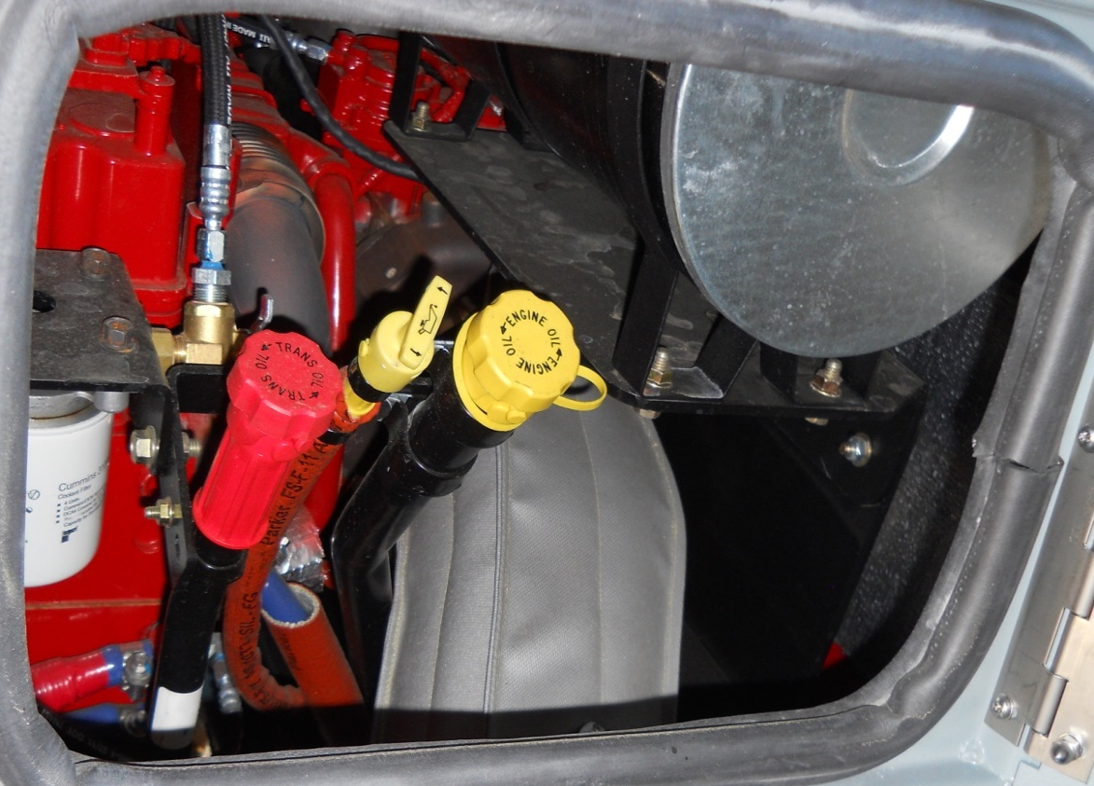
Before Placing in Service
Perform a Primary Inspection.
  Proper operation.
  Clean and lubricate
    Delivery travel and training.
    Check fluid levels

Slide 24
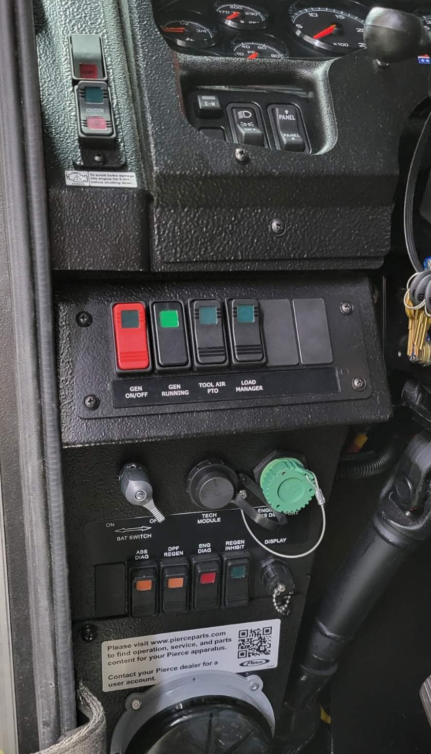
Proper Start/Shut Down
Battery switch ON
Ignition switch ON, wait for ignition PROVE OUT to complete 4-5 sec.
Start engine (Interlocks must be satisfied, Parking Brake set and transmission in Neutral)
Shut OFF engine using Ignition switch, leave Ignition OFF
Shut Battery switch OFF

Slide 25
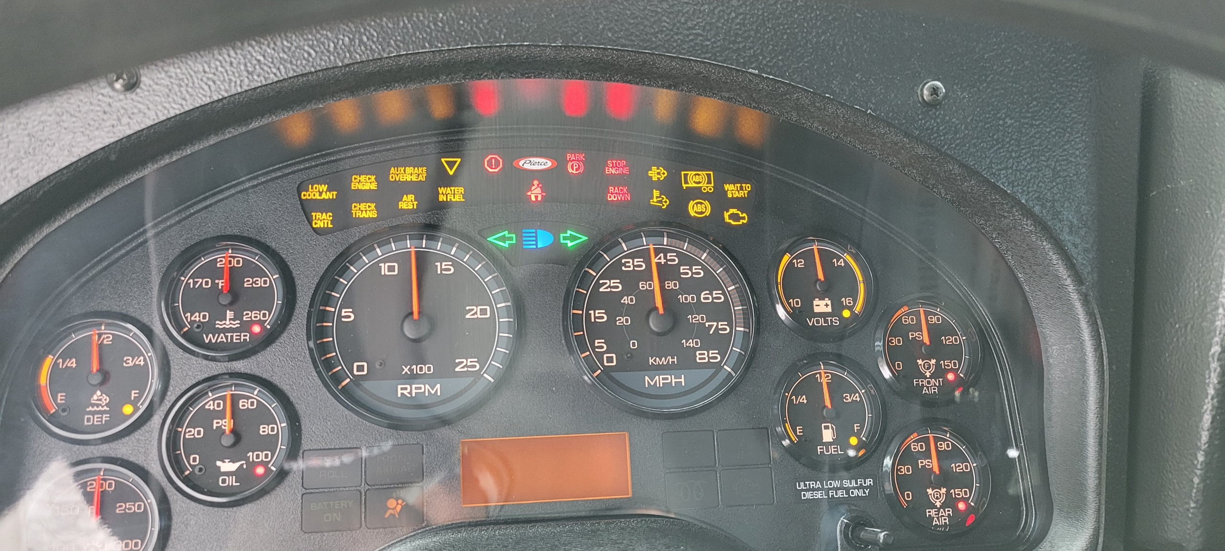
Cab Controls
Gauges and Warning Lamps

Slide 26
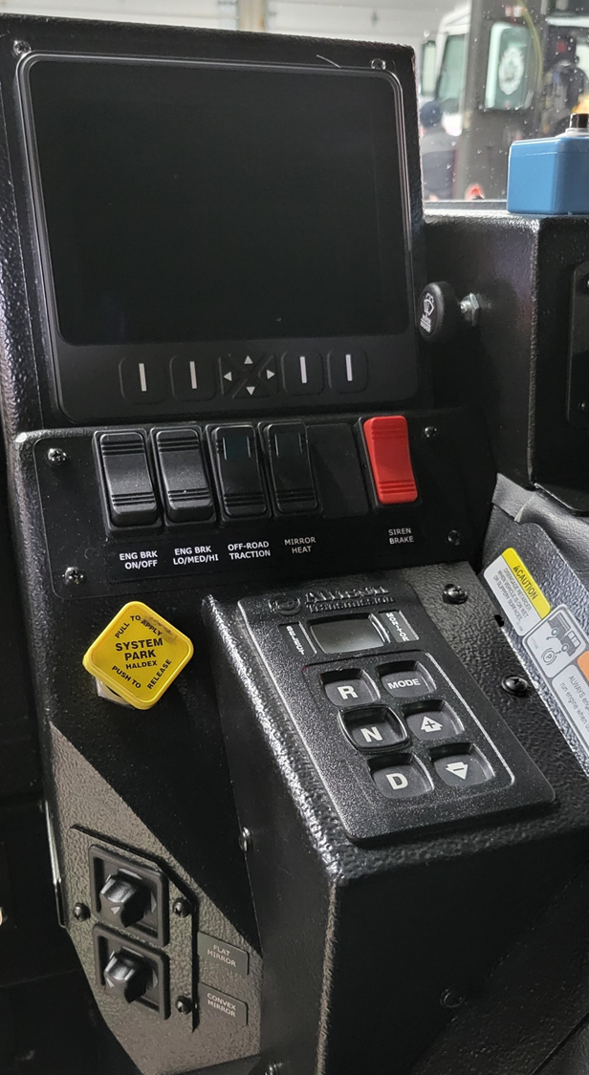

Slide 27
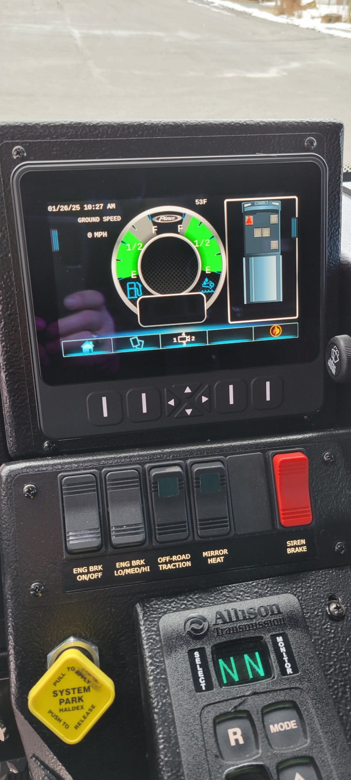
Seatbelt Monitoring System included in Command Zone

Slide 28
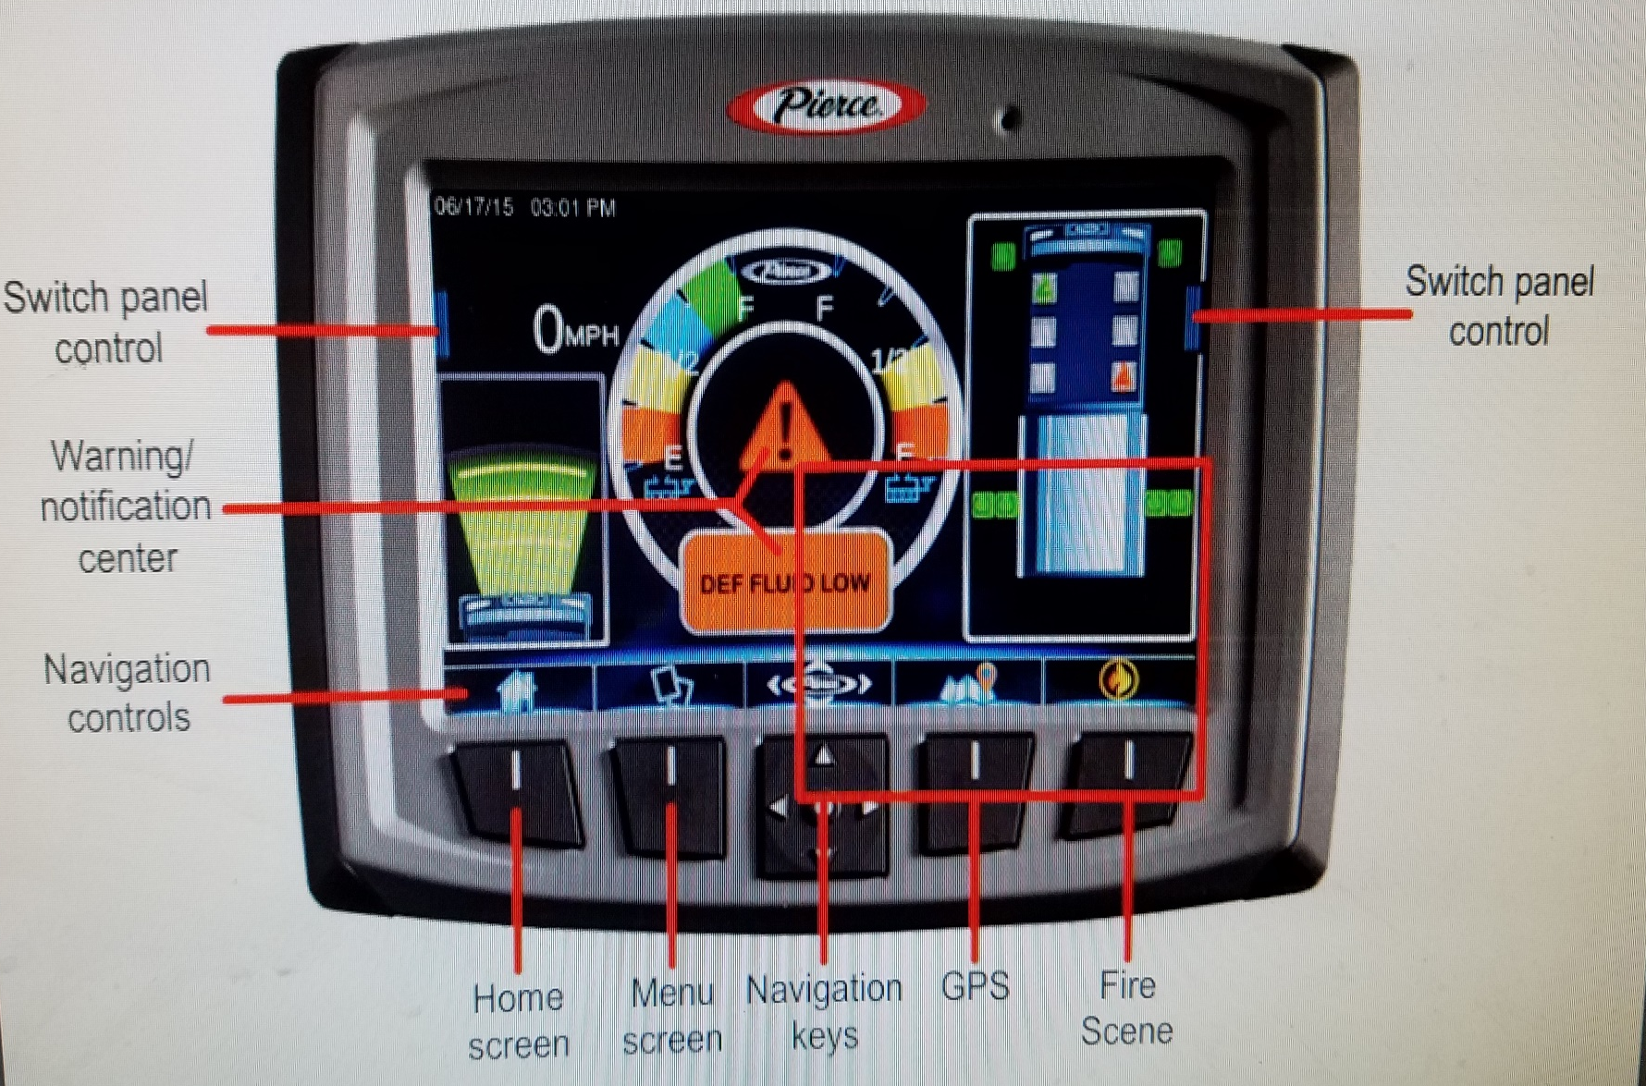
Command Zone III

Slide 29
Leave Load Manager ON at all times
The Load Manager protects the 12 V electrical system from failure
By fast idling the engine and then systematically sheds
predetermined electrical loads to keep the engine running and
Operating.
Fast Idle initiated if not ON
Heat and AC shed
12 V Scene lighting shed
Emergency Lighting

Slide 30
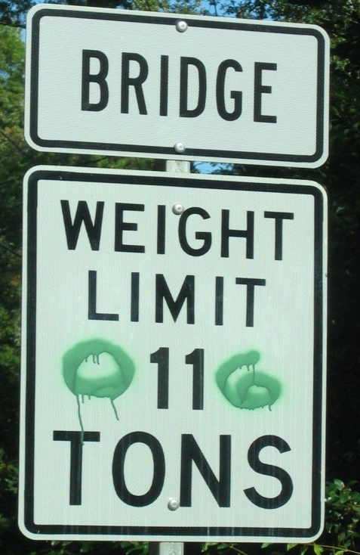
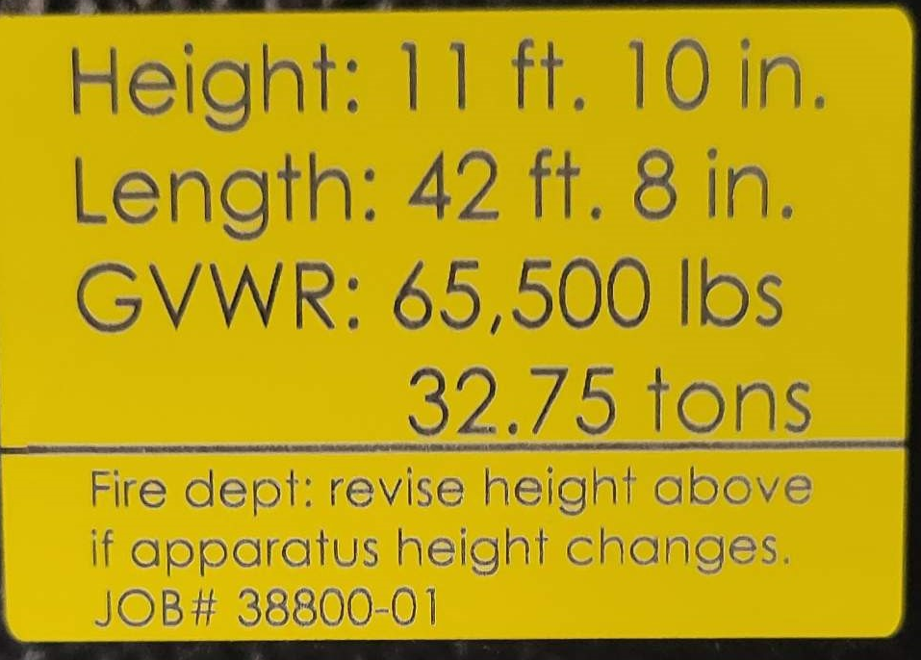
Positioning for Operations
Fires Scene
  Upwind from heat and flames
  Hot embers can get in the air intake
  Always leave a way out
  Avoid electrical lines
Road ways
  Protect emergency personnel
  Use response lighting
  Deploy wheel chocks & cones

Slide 31
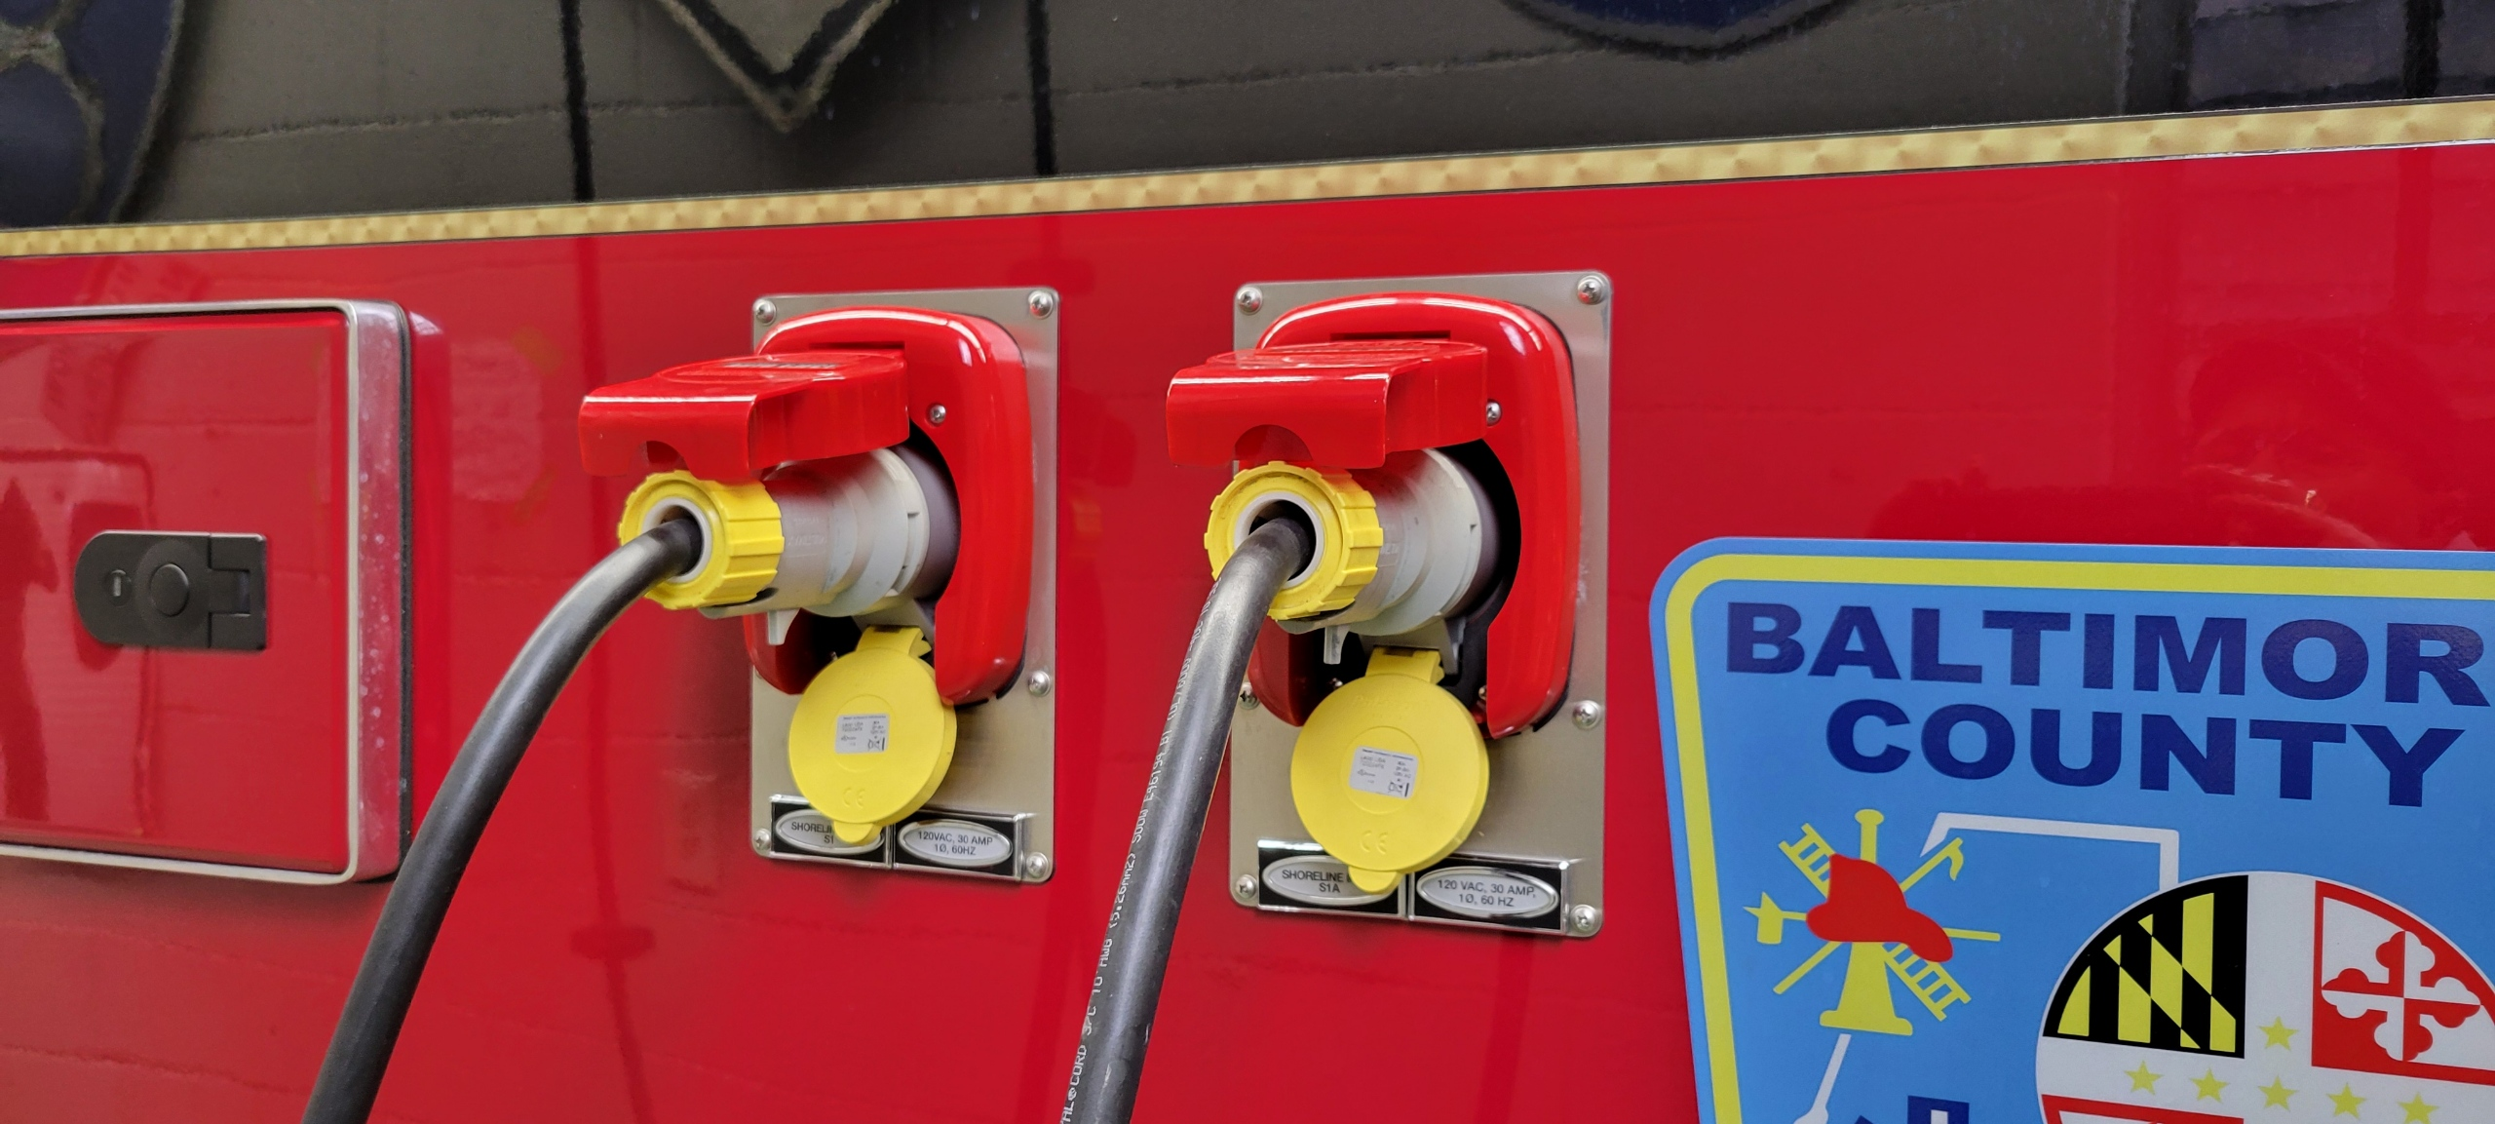

Slide 32
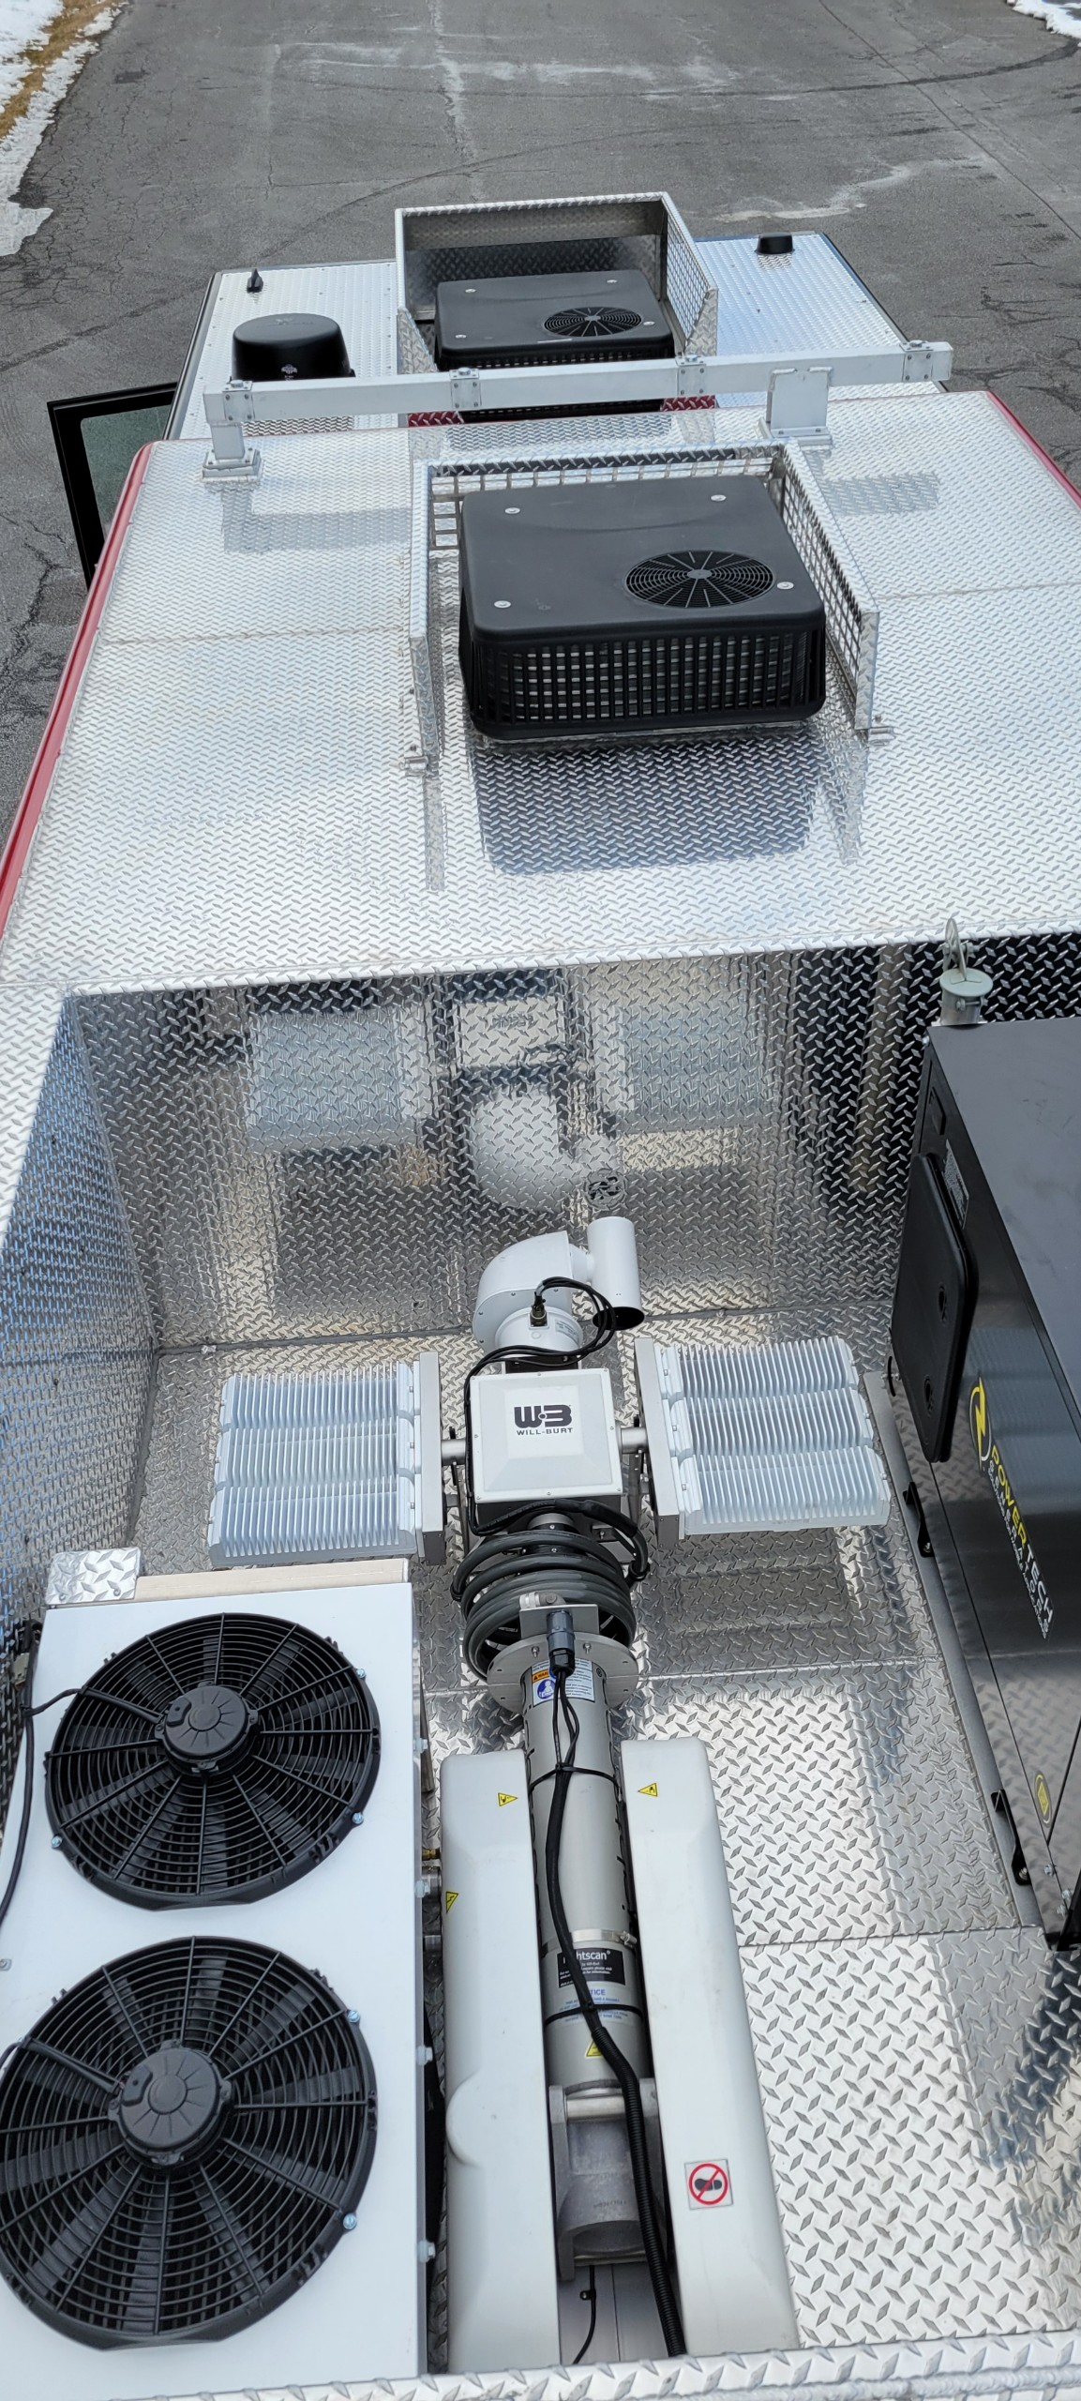

Slide 33

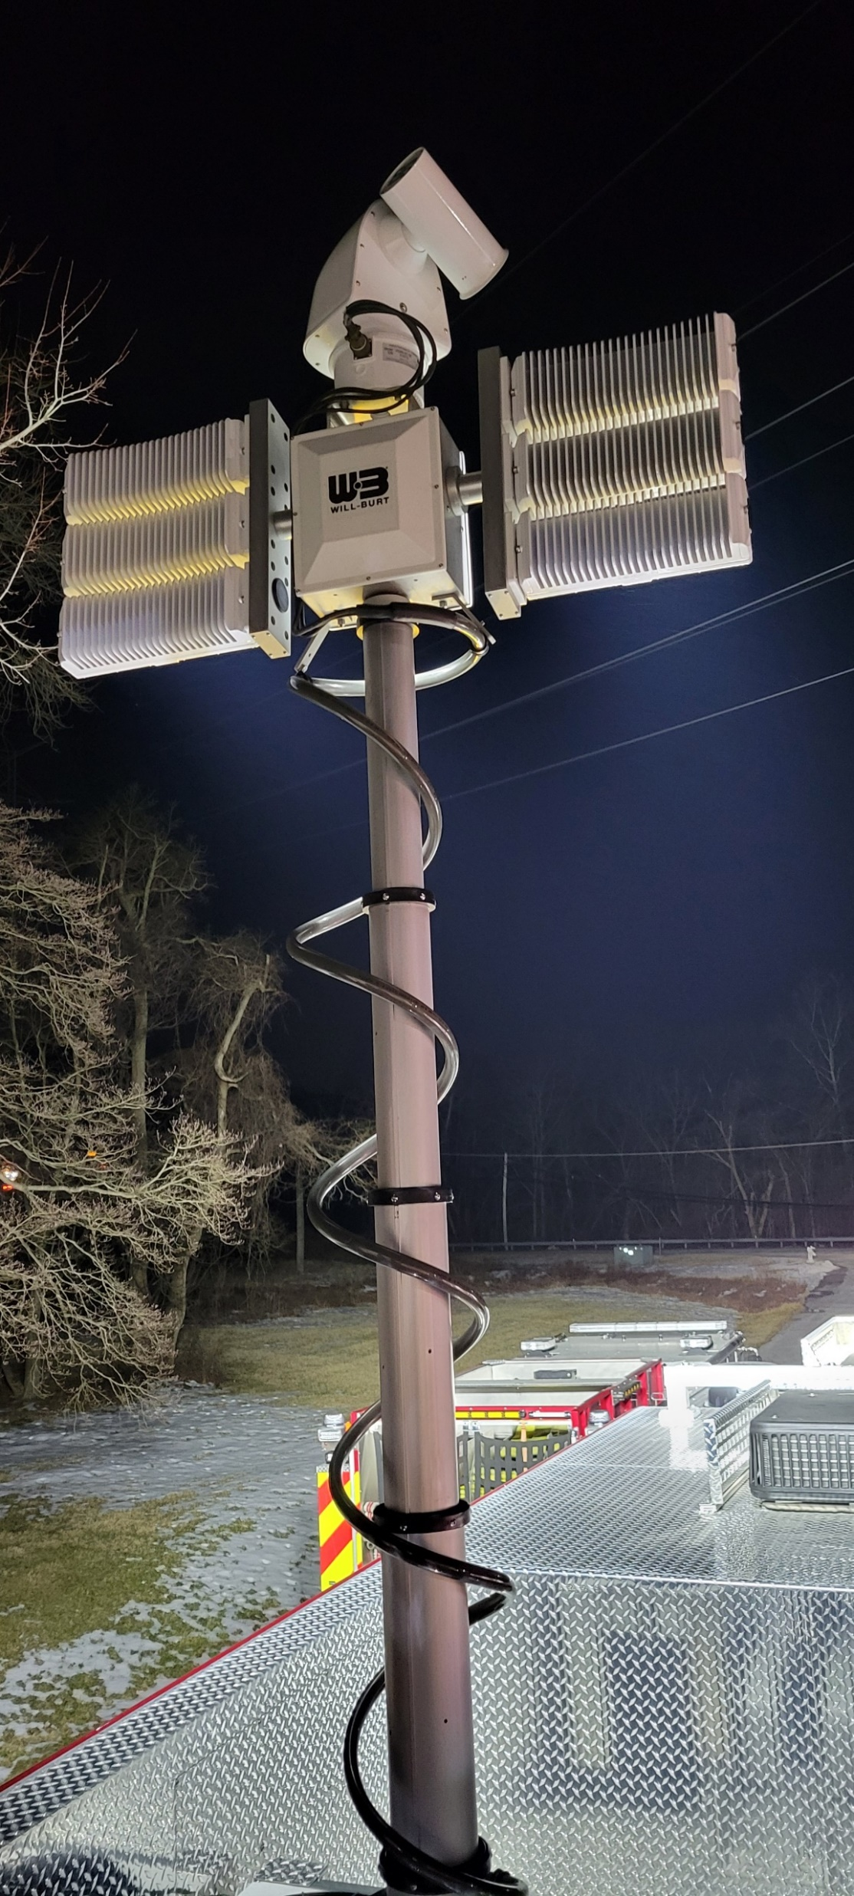
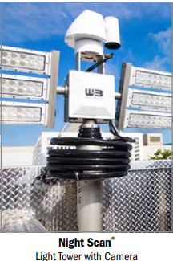


Slide 34
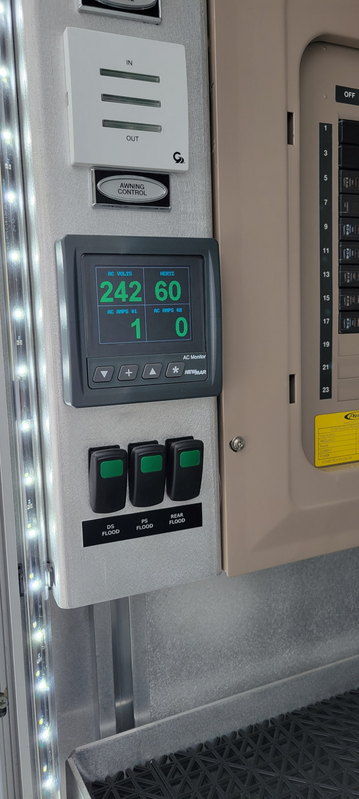
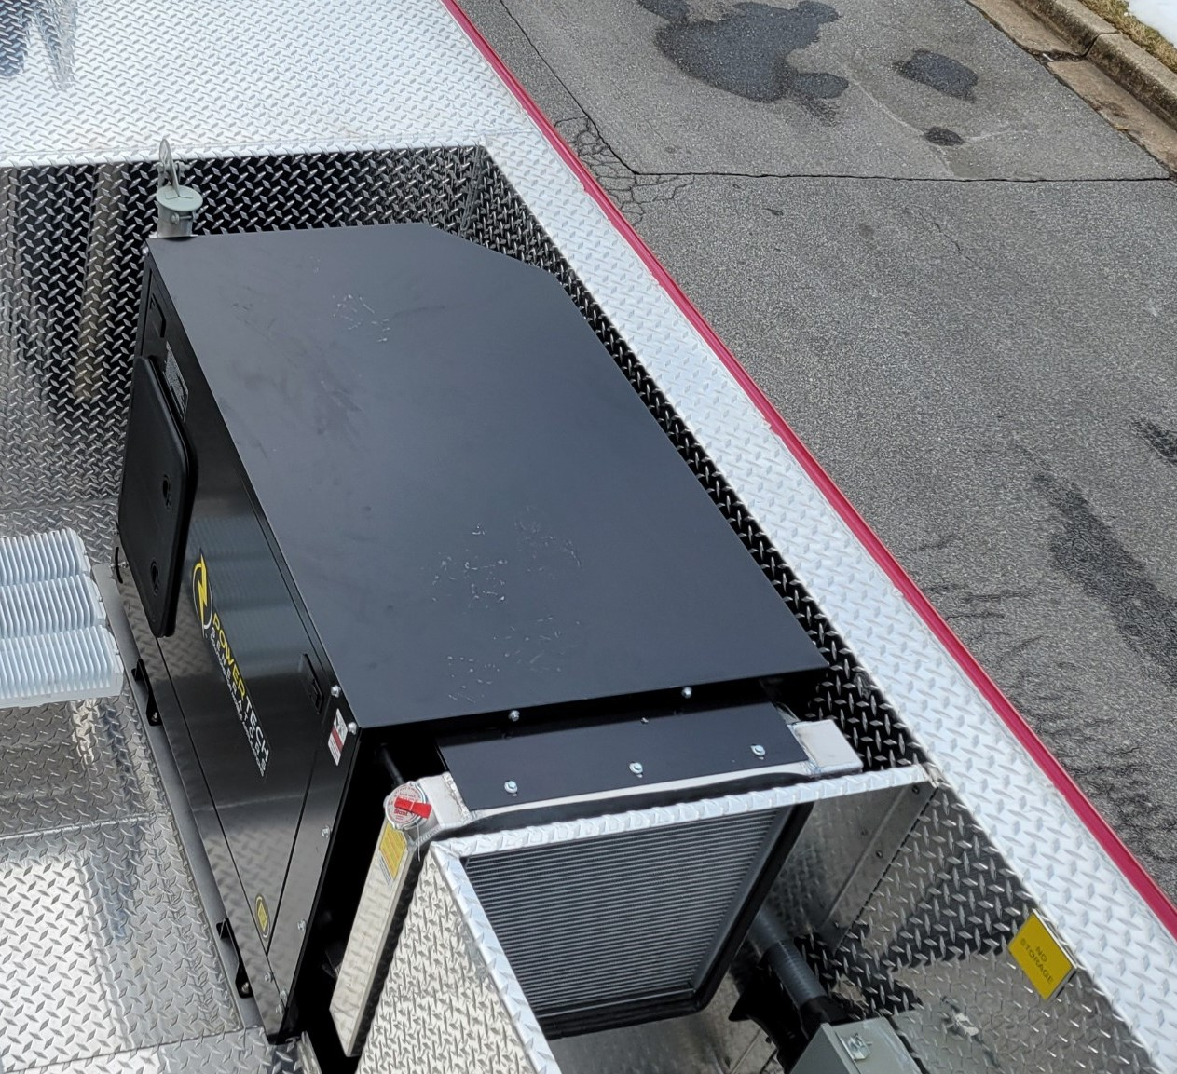
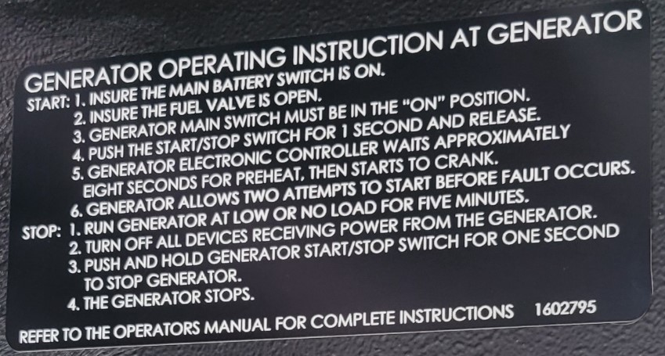
20 KW Power Tech – Diesel Generator

Slide 35
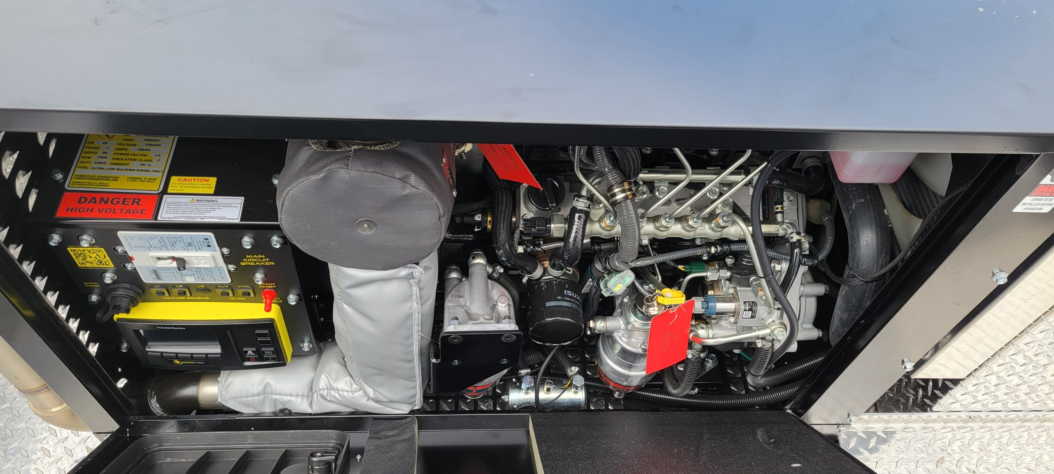

Slide 36
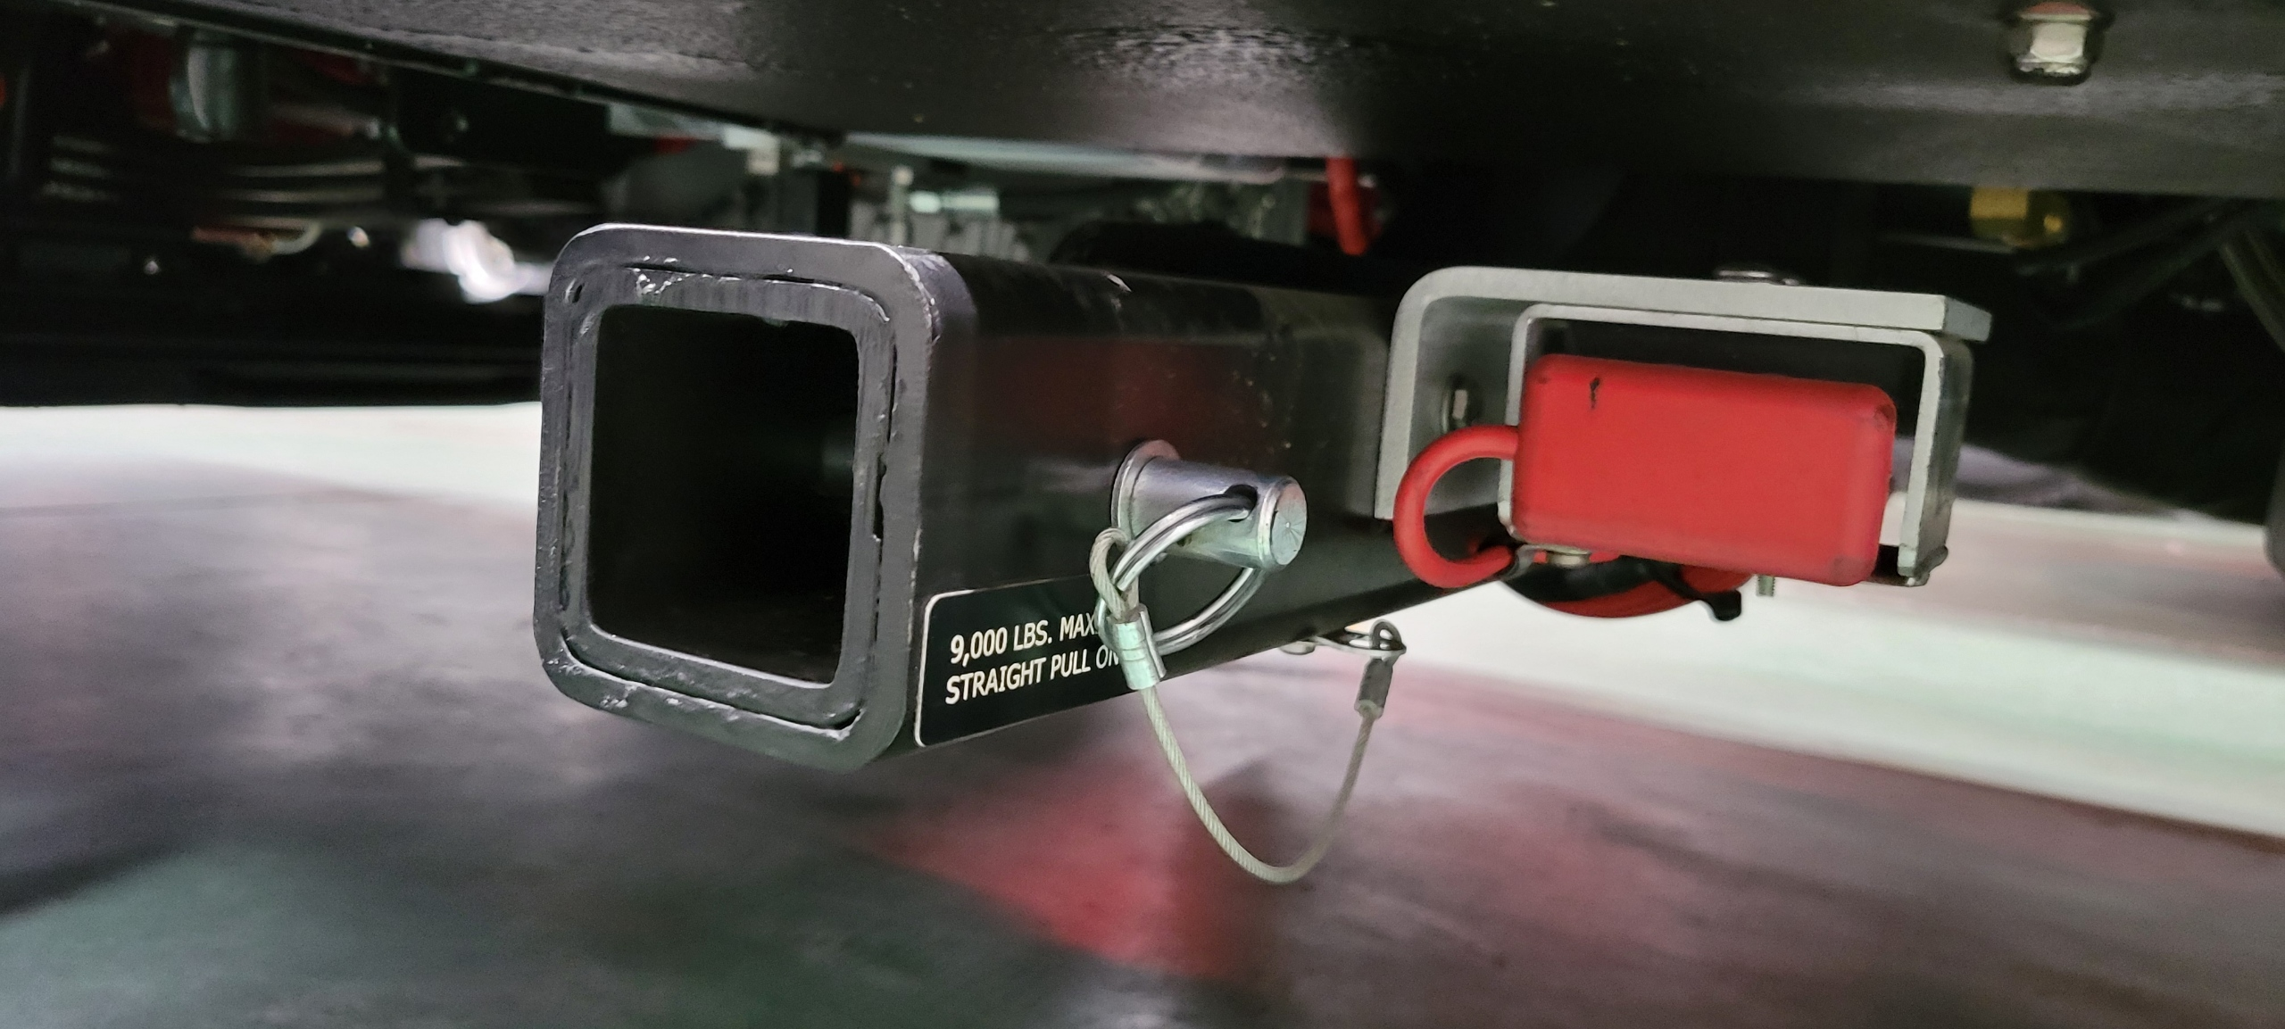
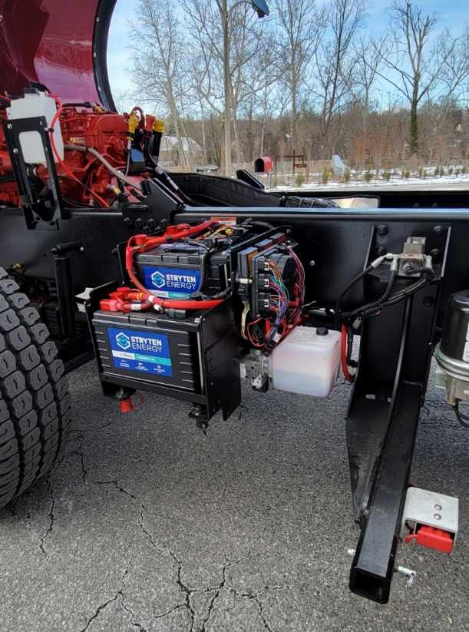

Slide 37
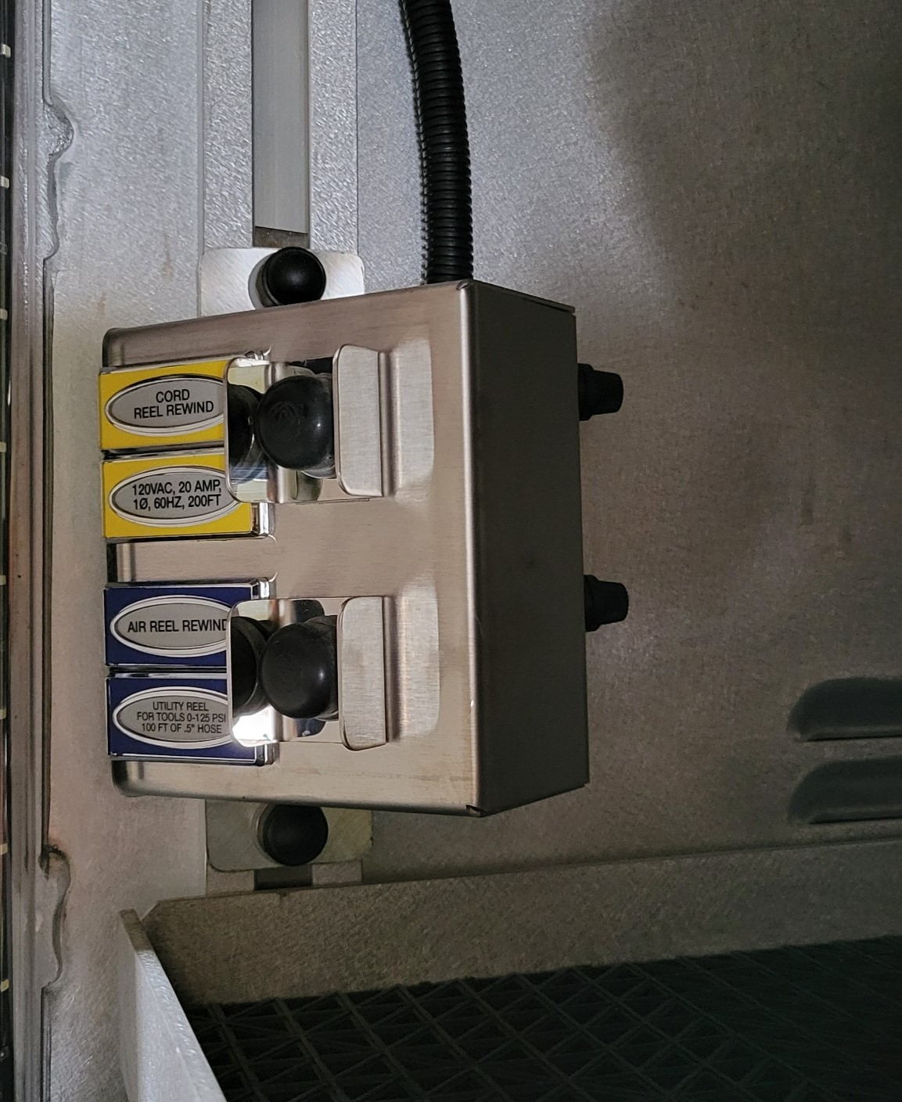
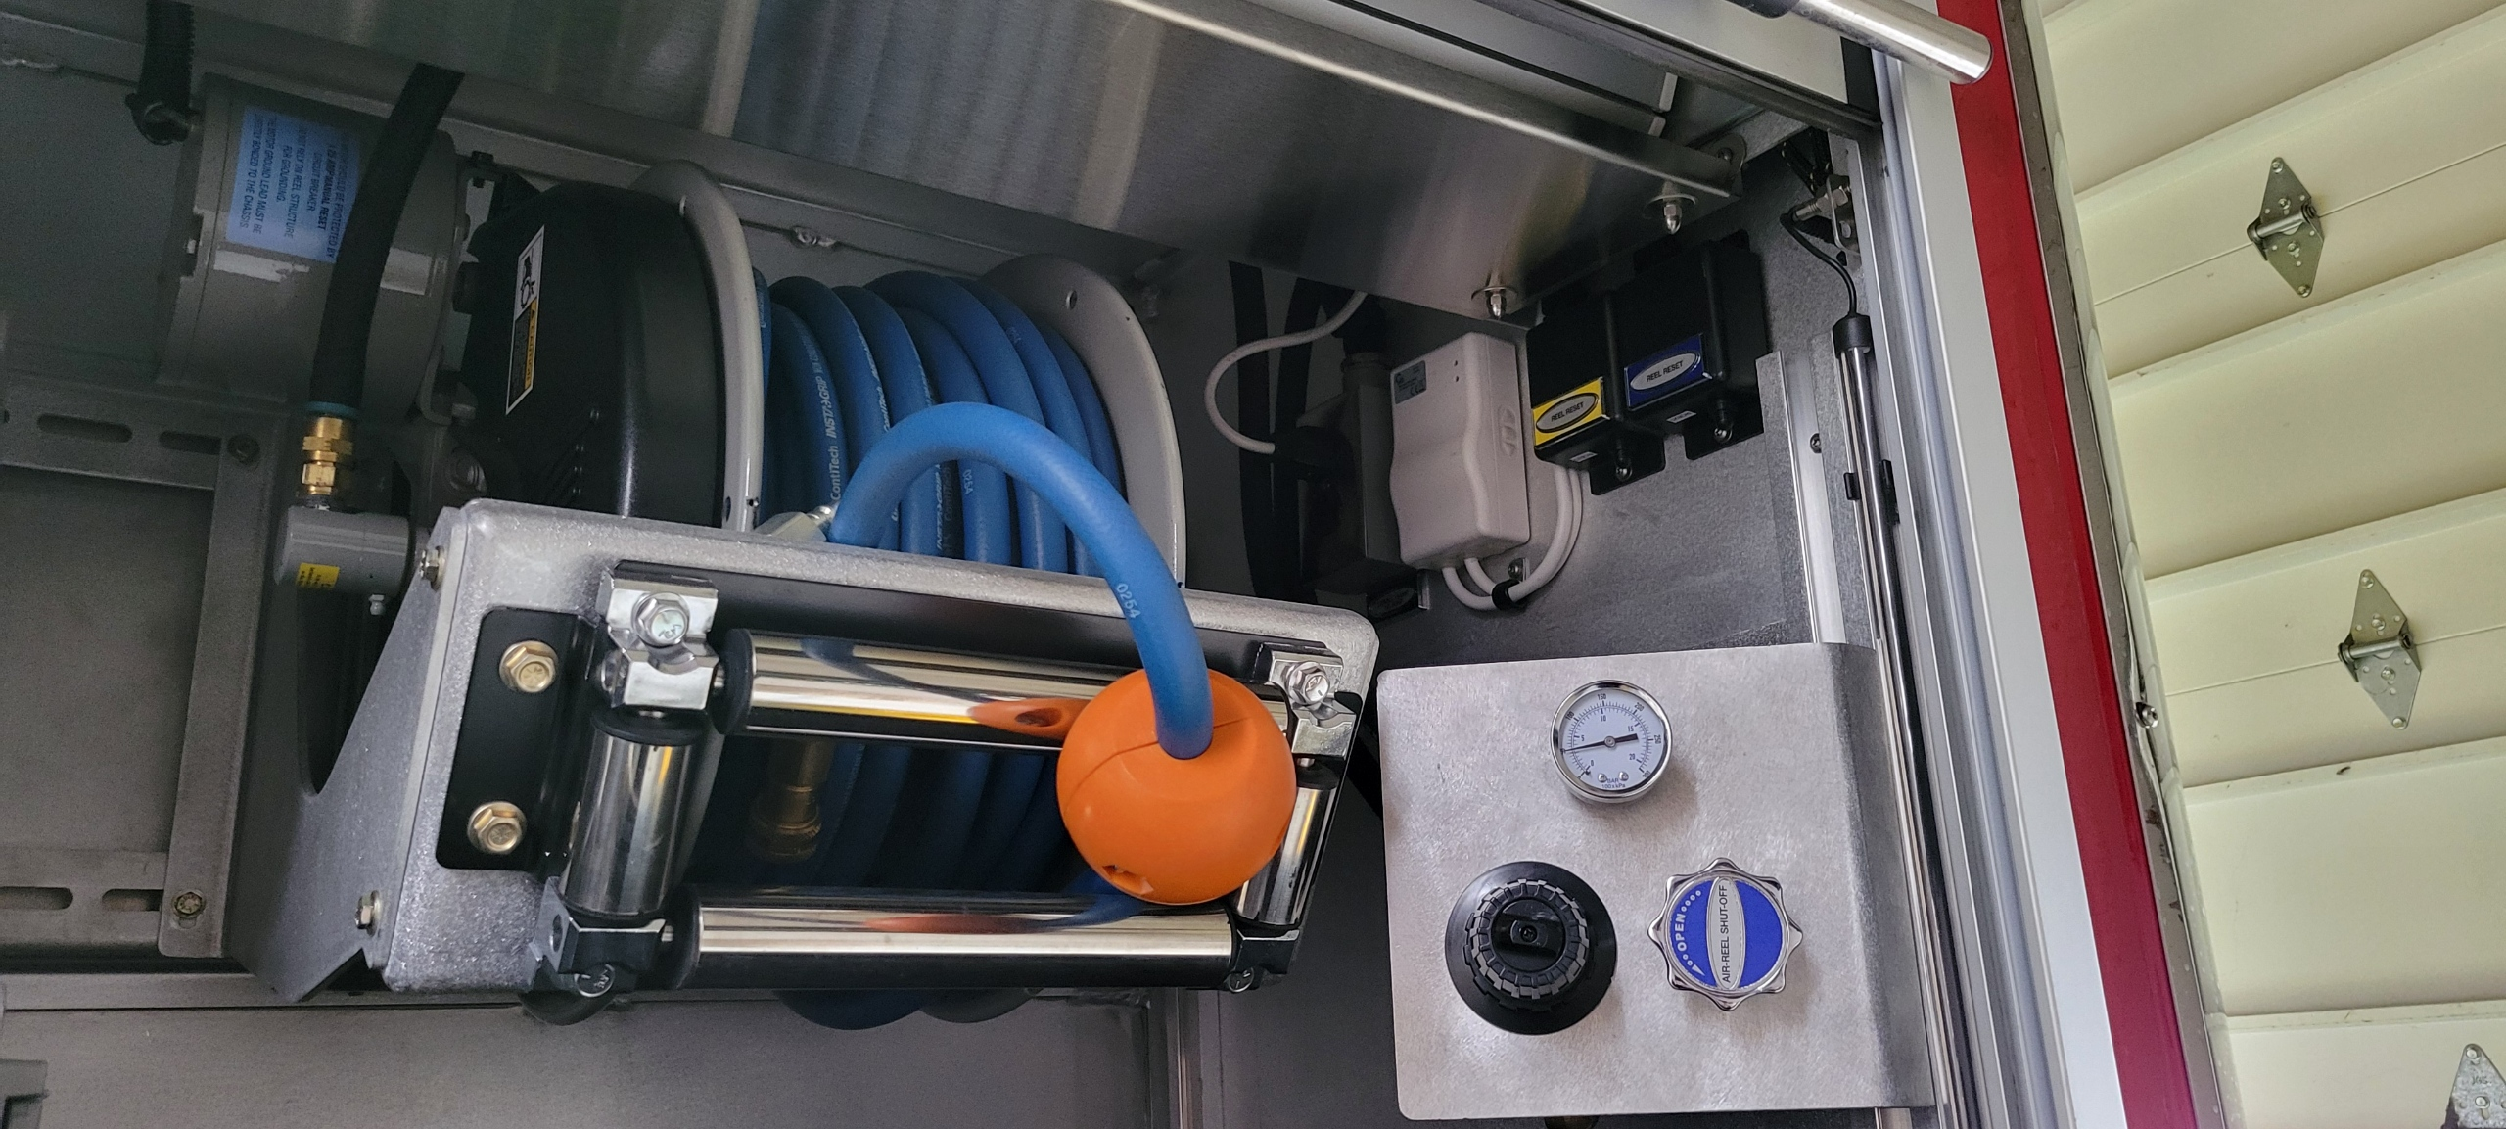
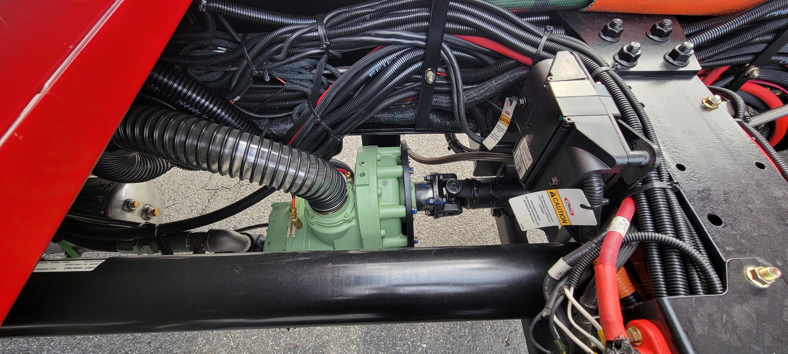
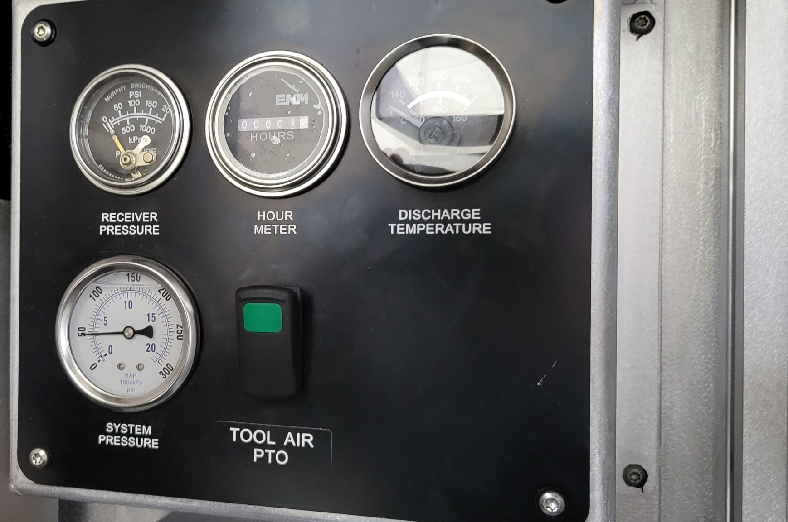
Vanair – Tool Air compressor 185 CFM – PTO driven

Slide 38
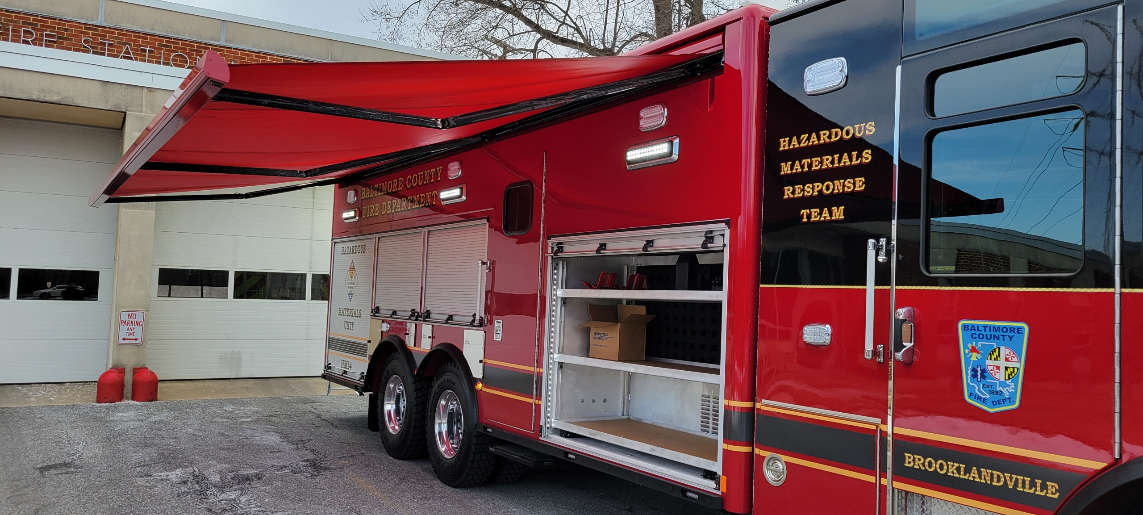
Girard electric awning – recessed both sides

Slide 39
Warranty
Pierce
  1 year warranty, 14 months from shipped date
  5 year Command Zone
  5 year Meritor axle
  *10 year paint pro-rate
  10 year structural body and cab
  15 year HDR structure
  3 year Goldstar lettering
  Lifetime (50 yrs.) frame rails

Slide 40
Warranty Continued
Engine
  Cummins X12– 5yrs.
  6 cylinder diesel, EPA 2024 eng. 500 HP
  1700 ft. lbs torque, 65 gal fuel tank
Transmission
  Allison 6th Gen– 5 yrs. 4000 EVS series
  6 speed automatic, with 2nd gear aggressive downshift

Slide 41
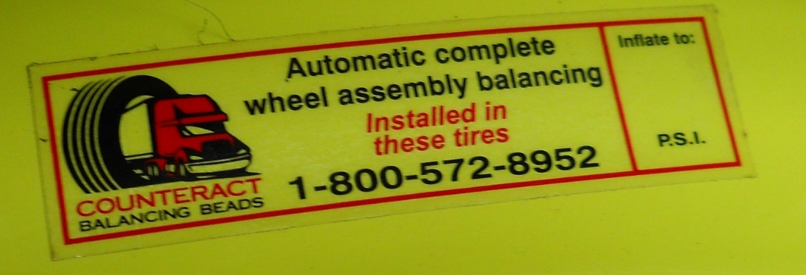
Tire Pressure
Refer to the Operations and Maintenance Manual for proper pressures
Proper inflation is important for safe handling, tire wear, and ride.
Tire Balancing- Counteract Beads

Slide 42
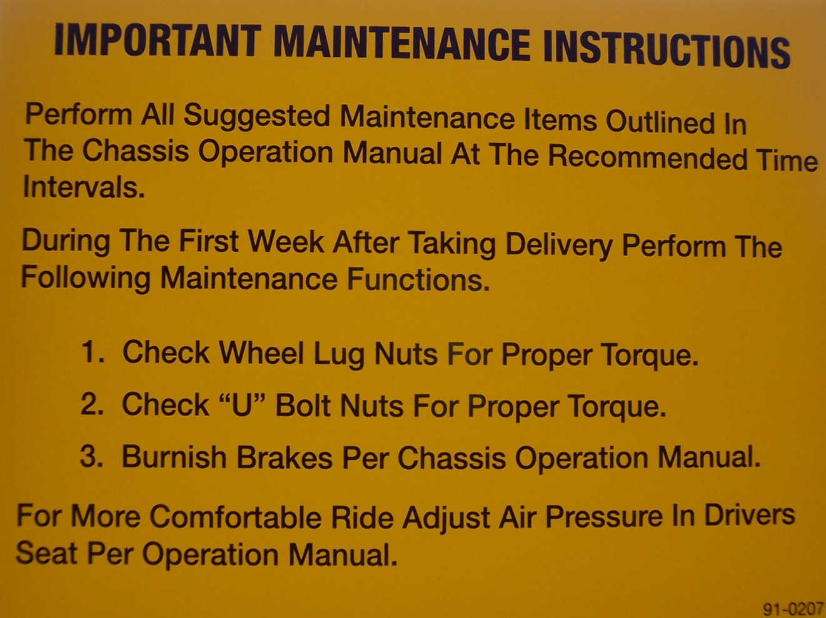
Service Procedures Before Placing in Service
Tighten spring suspension bolts
Check U Bolts
Burnish Brakes
*Done by AES at the Pre-Delivery Inspection

Slide 43
Service Bulletin
43
If it necessary to idle engine for more than FIVE minutes, the fast idle switch should be activated to increase the engine speed to at least 1000 RPM.

Slide 44
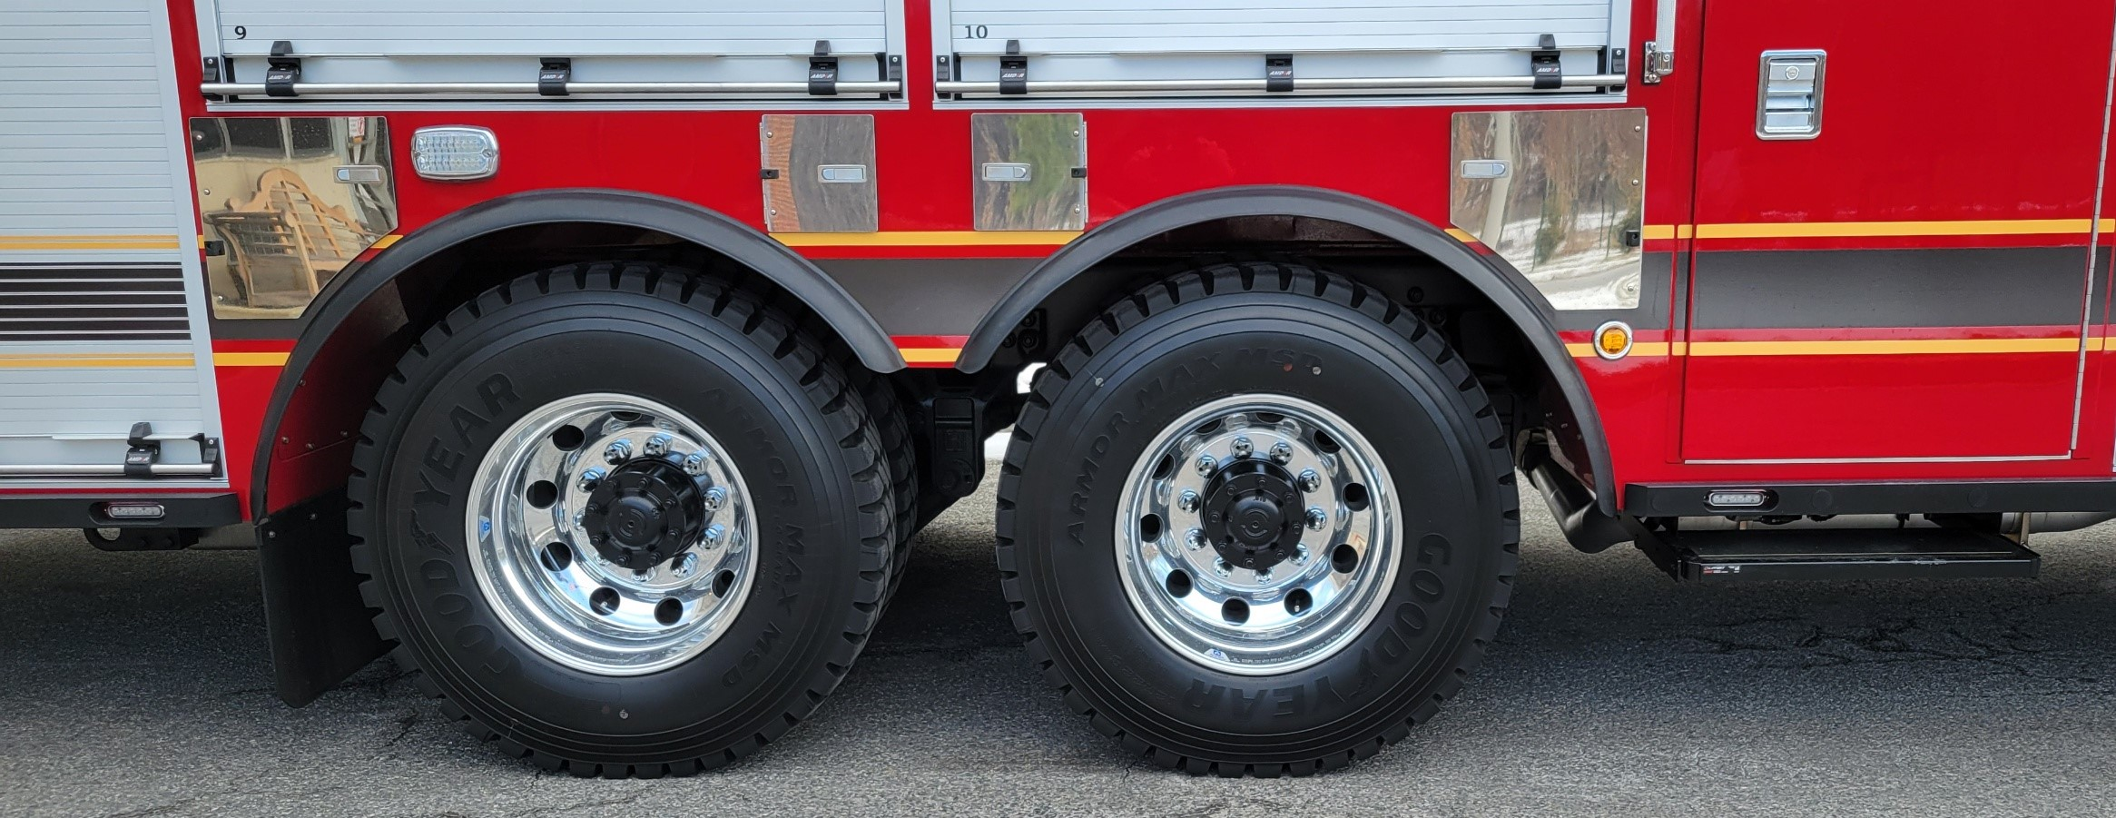
Care of Vehicle
Washing
  Can be washed any time after delivery
  Use mild non-abrasive liquid soap made for vehicles
  Avoid pressure washing
Waxing
  May be hand waxed 90 days after delivery
  Caution: Do not wax any of the Goldstar, gold leaf, or other vinyl. Wax around it (refer to owners manual)

Slide 45
Towing
Plan ahead, know who is capable of towing your apparatus.
Considerable damage may be caused by inexperienced tow truck operators.
Review the “Vehicle Towing” section of the Operations and Maintenance manual before hand with your local towing company (keep laminated copy in truck)

Slide 46
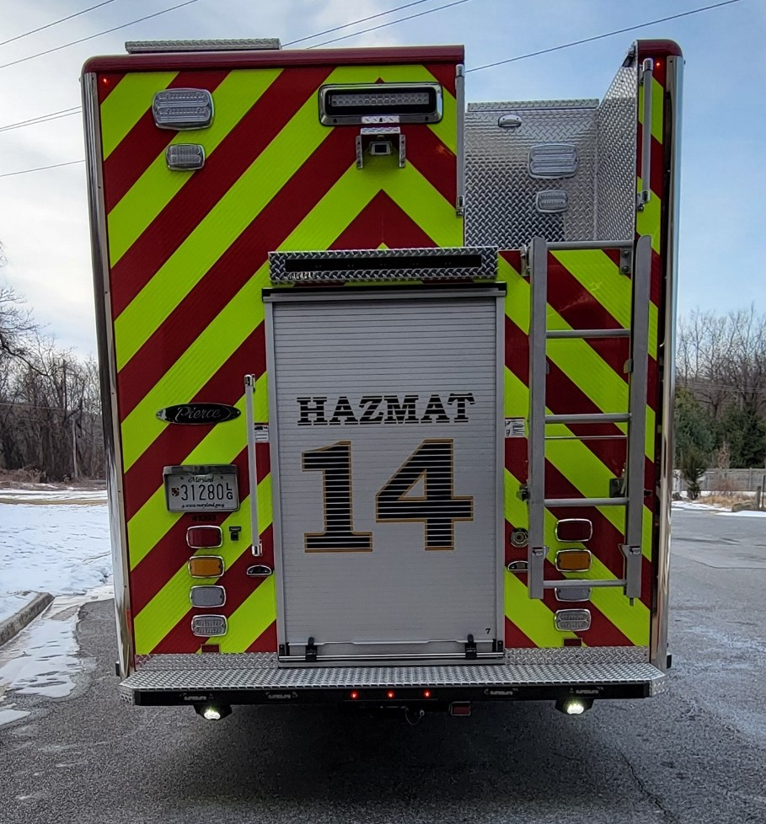
Questions?

