Slide 1
2024 Engines

Slide 2
Emissions Standards
Since 1994 significant reductions in PM & NO_{x}
EPA 2010 emissions standard:
0.2 g NO_{x}
0.01g Particulate Matter (PM)
1994
Pollutants
5.0
20%
1998
52%
4.0
38%
NOx [g/hp-hr]
2.5
2002
1.2
2007
83%
0.2
2010
0.01
0.10
90%
PM [g/hp-hr]

Slide 3
SCR Selective Catalytic Reduction

Slide 4
2007 System Architecture
2010
Diesel
Particulate
Filter
EGR-Cooler
Oxidation
Catalyst
Urea Doser
SCR Catalyst
Charge Air Cooler
Urea
Urea Tank
Slide Courtesy of Detroit Diesel®
Notes:
For 2010, the existing 2007 technology is used, with the addition of the Selective Catalytic Reduction (SCR) system.

Slide 5
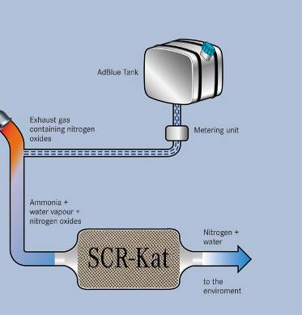
Slide Courtesy of Detroit Diesel®
How SCR Works
= Exhaust
= Diesel Exhaust Fluid
Particulate Matter (PM) is trapped
in the Diesel Particulate Filter
(DPF)
DEF injected into the
exhaust stream
NOx
PM
DEF
NOx
PM
Ammonia (NH3) and Nitrogen
Oxides (NOx) react in the catalyst
to form Nitrogen and Water
NH3
DEF solution ‘hydrolyzes’ into
ammonia gas (NH3) which mixes
with the exhaust
SCR Device
N₂
H₂O

Slide 6
DEF Diesel Exhaust Fluid

Slide 7
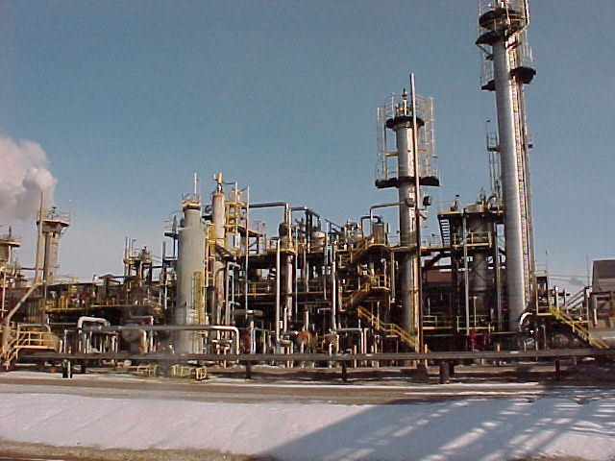
Diesel Exhaust Fluid
Made from Ammonia (a natural gas by product)
Clear
Biodegradable
Freezing point = 12° F

Slide 8
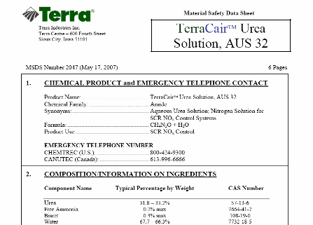
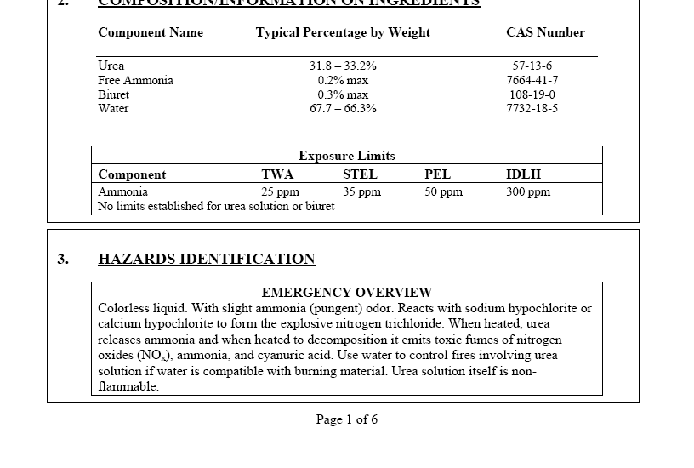
Diesel Exhaust Fluid
Material Safety Data Sheet (MSDS)
Hazards Identification “Urea Solution is not Flammable”
First Aid Measures “Wash area thoroughly with soap and water”
Fire Fighting Measures “Urea solution is not flammable”
Transportation Information “Urea solution is not listed by any US or Canadian transportation authority as a hazardous material…”

Slide 9
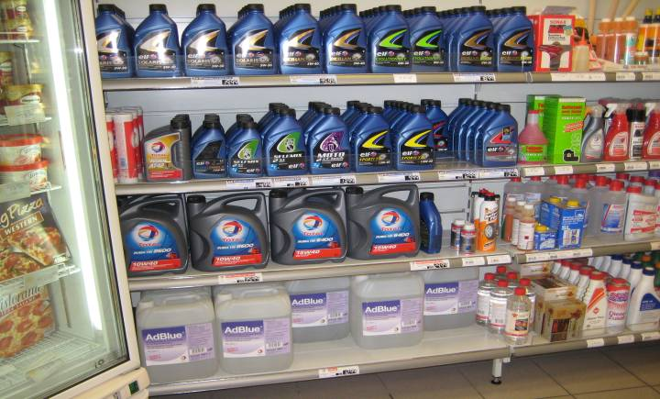
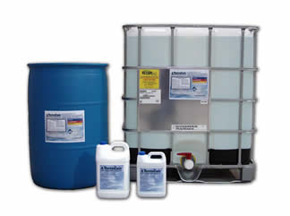
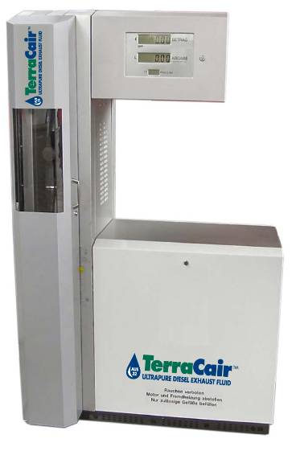
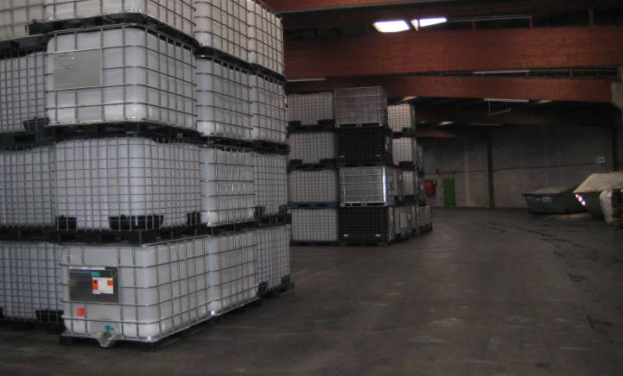
DEF Packaging
Jugs
Totes
Pumping Stations

Slide 10
How Much DEF Will I Use?
Approximately 2% DEF consumption
Every 50 gallons of fuel =
1 gallon of DEF
Notes:
We expect about 2% DEF Consumption. Great opportunity to help educate and advise users on consumption rate. Depending on number of 2010 units in a fleet, users can begin planning on actual inventory of DEF that is needed in their shops…..barrel vs. tote, etc.
You can plan to consume about 1 gallon of DEF for every 50 gallons of fuel

Slide 11
CUMMINS

Slide 12
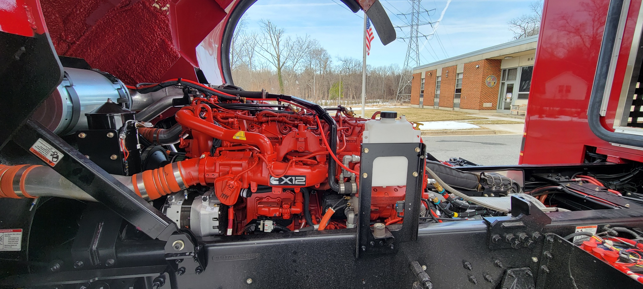
Cummins X12
Increased Power Density
500 HP 1700 ft-lb Torque
Heavy Duty Design
Replaceable Liners
Advanced VG Turbocharger
Selective Catalytic Reduction Aftertreatment System
Improved Reliability
Notes:
The 2010 ISC8.3/ISL9 is built like a heavy duty engine with replaceable wet liners, roller followers, 2 piece steel articulated pistons, by-pass oil filtration and targeted piston cooling. It features an improved Combustion System along with Optimized Calibration for lower Engine Out Particulates.
The cooled-EGR subsystem has set the industry standard for reliability since 2002 and a more robust Electronic Control Module (ECM) on the 2010 ISC8.3/ISL9 not only controls operation of the engine and the new Cummins Aftertreatment System, it coordinates seamlessly with other vehicle systems such as the transmission and brakes. The ISC.3/ISL9 will run at near-zero emission levels, and will achieve comparable fuel efficiency to the ’07 ISC/ISL.
Exceptional performance will be delivered with our proven technology, including High Pressure Common Rail fuel injection, our patented VG Turbocharger, and the new Cummins Aftertreatment System. The High Pressure Common Rail Fuel System delivers an optimum balance of performance, emissions control and fuel economy across the entire operating range.

Slide 13
SCR Vehicle Impact Custom Chassis
65 gal.
Diesel
Fuel
4.5 gal.
DEF
13
Notes:
13
DEF tanks will always be located on the LH side of the vehicle.

Slide 14
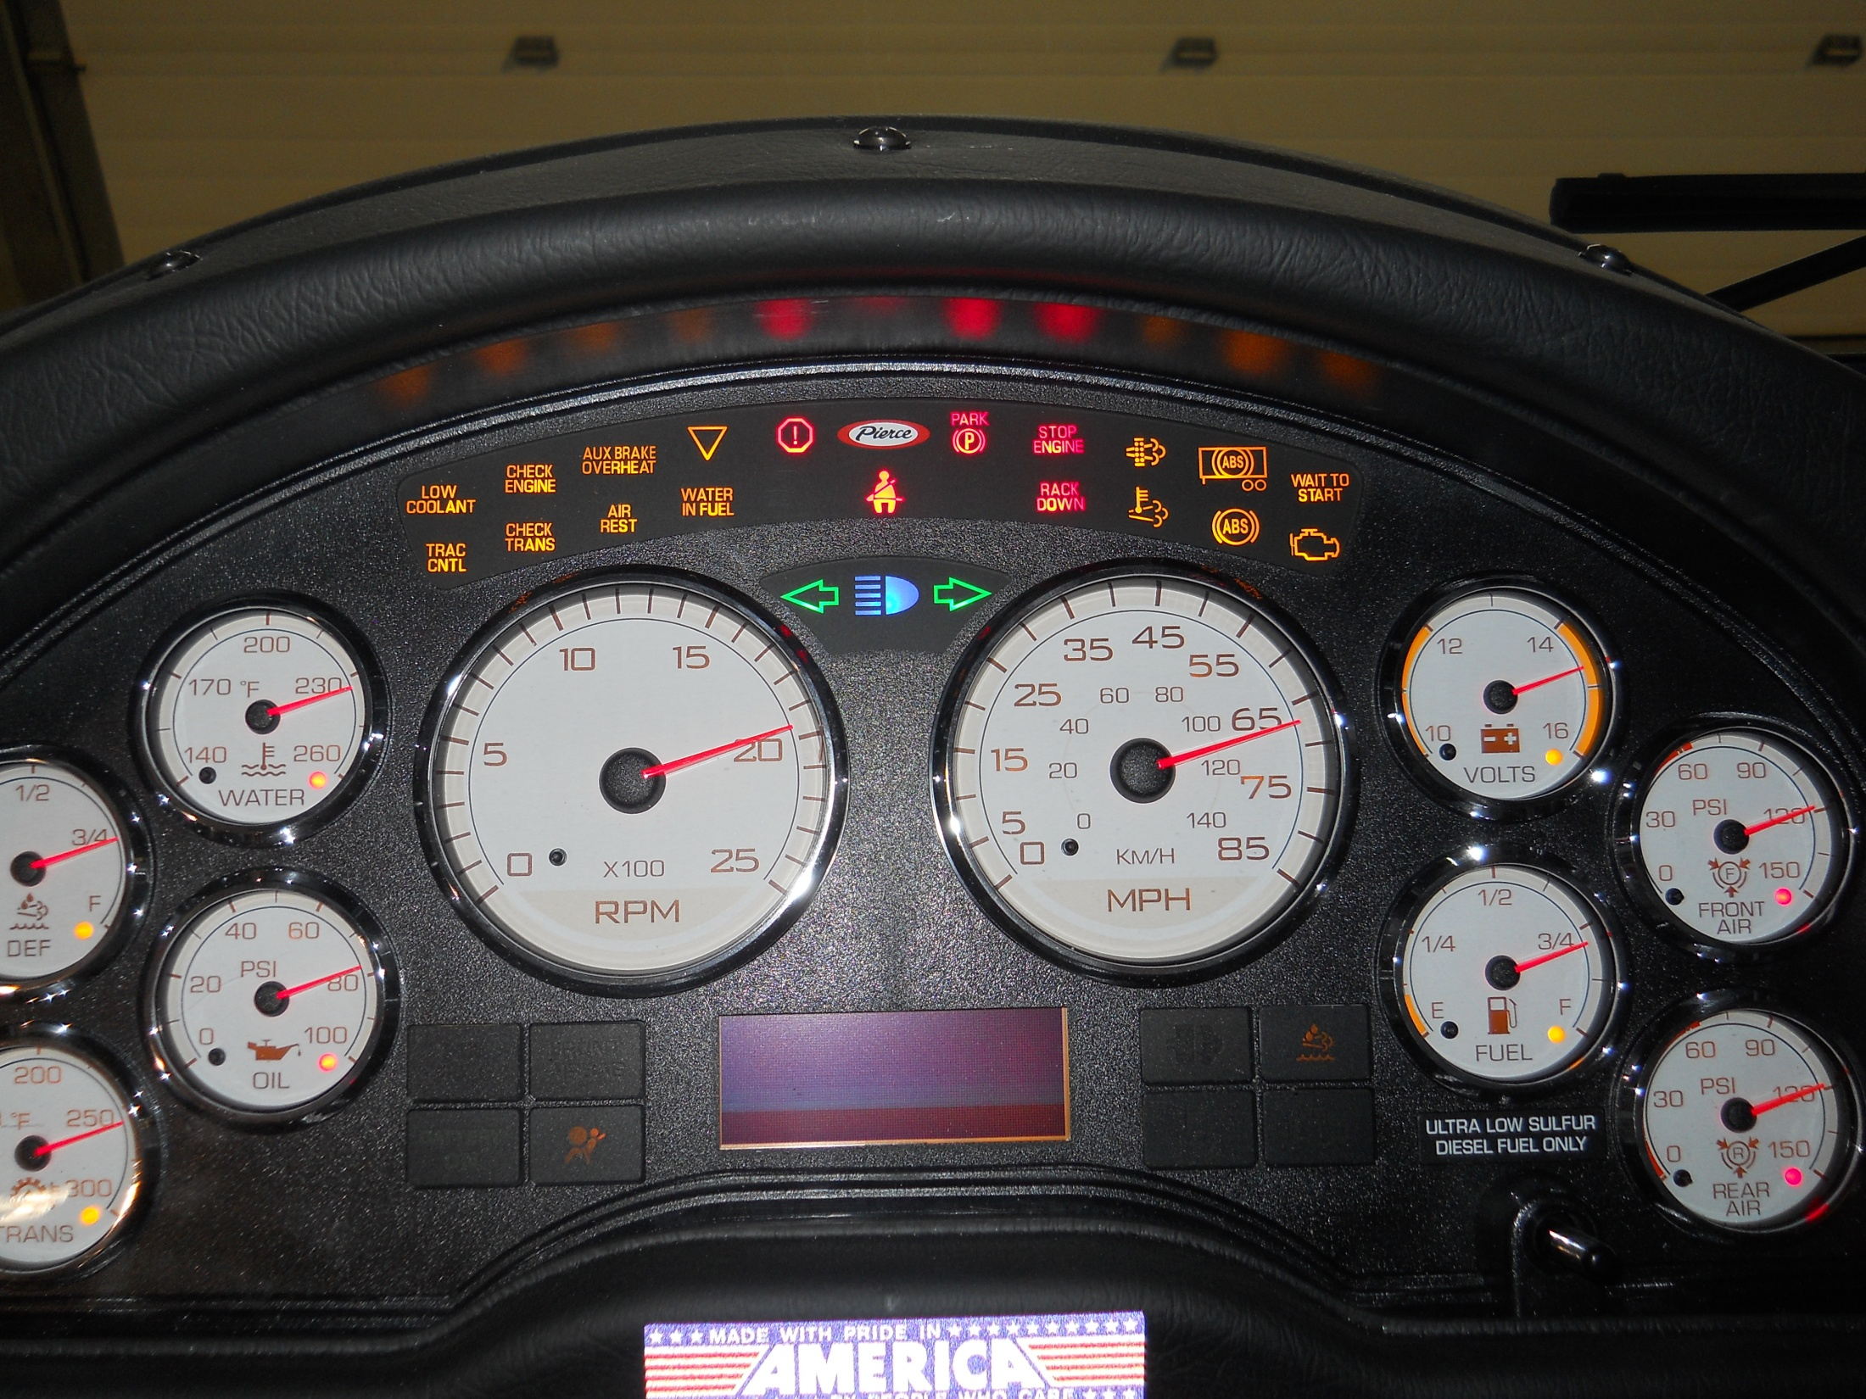
Cab Controls Gauges and Warning Lamps
Tachometer
Speedometer
Display Module
Rear Air pressure
Front Air Pressure
Voltage
Transmission Oil Temperature
Oil pressure
Fuel
Coolant Temperature

Slide 15
Cab Controls Gauges and Warning Lamps
Tachometer
Speedometer
Display Module
Rear Air pressure
Front Air Pressure
Voltage
CEL (Check Engine Light) will prevent engine from conducting a Regen
Fuel

Slide 17
