Slide 1


Slide 2
Baltimore, MD
T100T08s (74328)

Slide 3
Rosenbauer
Safety Information
Please read all safety information!!
Safety Introduction
Familiarize yourself with all manuals supplied.
Read and follow all safety precautions
DO NOT MODIFY any equipment without authorization from the factory
Keep ignition sources away from flammable objects
Practice good housekeeping.

Slide 4
Safety Harnesses
For the safety of everyone on your crew. A safety harness MUST BE WORN at ALL TIMES by any individual on the aerial!

Slide 5
Positioning the Truck for Operation
Determine if the aerial will be used as a water tower or for rescue.
Make sure to note ALL overhead obstructions.
Scan scene to position the truck for best attack.
NOTE: For the best positioning, a corner of a building is highly suggested. This gives the operator access to two sides of the structure as well as the roof.
REMINDER: The operator should always observe the placement of the fire fighting vehicle to be sure that there is enough space for the stabilizers to be set and the aerial to be operated without any obstructions.
Obstructions to be most aware of include, but are not limited to: adjacent buildings, curbs, drop-offs at road edges, man holes, vehicles, trees, over head electrical wires, ditches and culverts.
When setting up the stabilizers the ground must be firm. It is highly recommended that the operator uses the outrigger pads provided. Setting up over manholes, underground parking facilities or storm drains could cause serious damage to the operator and/or serious damage to the truck. The area must be able to support 75 PSI

Slide 6
Setting Front of Truck to UPHILL Grades
With maximum grades the truck should be positioned with the cab facing uphill. Aerial should be operated over the rear.
Advantages:
  Can reduce the truck’s grade by extending the rear outrigger stabilizer jacks.
  When truck is set up the front tires will be in contact with the ground.
  With the outriggers set operator has more ballast for the operation of the aerial.

Slide 7
Setting Front of Truck to UPHILL Grades
Disadvantages:
Since only the front tires are on the ground there is less resistance to prevent truck movement.
The rear compartment and aerial access step are more difficult to access.

Slide 8
Setting Front of Truck to DOWNHILL Grades
Advantages:
Rear compartments are closer to the ground for easier access.
Better resistance to keep the truck from sliding by having more tires in contact with the ground.

Slide 9
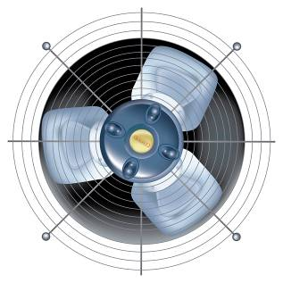
Safety Around the Vehicle
EXHAUST FUMES
Be conscious of exhaust fumes when working around the vehicle.
Ensure that there is adequate ventilation.
DO NOT alter emission controls.
COOLING SYSTEM
Ensure there is adequate clearance between fan and shroud.
DO NOT alter fan ratio, spacers or position.
Observe fan clutch operation to ensure fan is disengaging when cooling is not necessary.
AIR INTAKE SYSTEM
DO NOT alter any intake piping or filter locations.

Slide 10
Safety Around the Vehicle
UNDERCARRIAGE
Notify others when working underneath the vehicle.
Keep away from moving parts.
Avoid hot areas such as engine, transmission, exhaust and pumps.
Avoid ports that may eject steam or other hot fluids.
COVERS AND DOORS
DO NOT sit, stand, climb or hang on open doors.
Some doors are spring loaded. Use caution when opening doors.
Use care not to get fingers and hands caught in pinch points such as hinges.
Do not drive with doors partially closed.
TIRES AND WHEELS
DO NOT operate vehicle with damaged or improperly inflated tires.

Slide 11
PRECAUTIONS FOR DRIVING SAFETY AND AERIAL OPERATION

Slide 12

Vehicle Safety
ENTERING, EXITING AND CLIMBING
Keep steps, handles, rails, walking surfaces and shoes free from grease.
Use extreme caution during inclement weather or when surfaces are wet.
DO NOT use pump fixtures or lights as stepping surfaces.
Make deliberate movements when entering, exiting or climbing on the vehicle. DO NOT rush.
DO NOT climb in areas without slip resistant surfaces and hand holds.
Use a three point stance in which three extremities are in contact with the vehicle, when entering, exiting or climbing on the vehicle.

Slide 13

Vehicle Operational Safety
VEHICLE BACKING
Use a spotter when backing vehicle.
Establish hand or verbal communication prior to backing.
During periods of low light use spotter with wands and reflective vests.
VEHICLE CONTROL
Ensure proper tire inflation before operating vehicle.
A neutral safety switch prevents vehicle from being started in gear.
Allow starter to cool for one minute if vehicle doesn’t start within 15 seconds.
Familiarize yourself with gauges, switches and on-board accessories prior to operating vehicle.

Slide 14
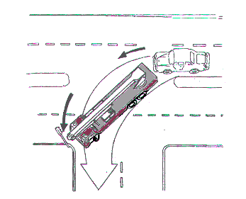
WATCH YOUR TURNING!
Increased overhangs, particularly at the rear, must be kept in mind.
NOTE: In narrow crossings the driver must confirm that there is enough space for turning.

Slide 15
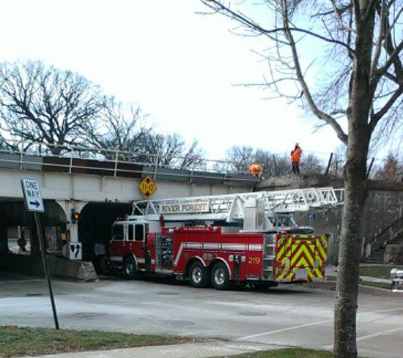
KNOW YOUR TRAVEL HEIGHT!

Slide 16
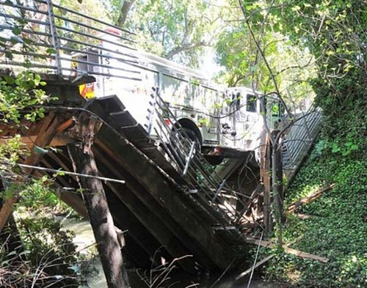
KNOW YOUR TOTAL WEIGHT!
NOTE: The driver must confirm the vehicle can freely pass limited weight areas.

Slide 17
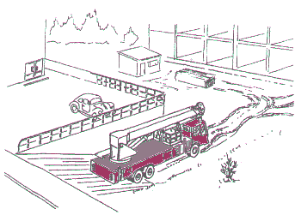
WATCH YOUR ANGLE OF DEPARTURE!
Ground clearance and the angels to front and rear structures
Our ground clearance is 8°

Slide 18
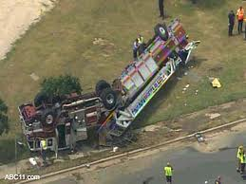
REMEMBER HIGH CENTER OF GRAVITY!
HEIGHT OF THE CENTER OF GRAVITY.
NOTE: Speeding with the vehicle when turning a corner is DANGEROUS!
REMEMBER 60% OF YOUR WEIGHT IS ABOVE YOU

Slide 19
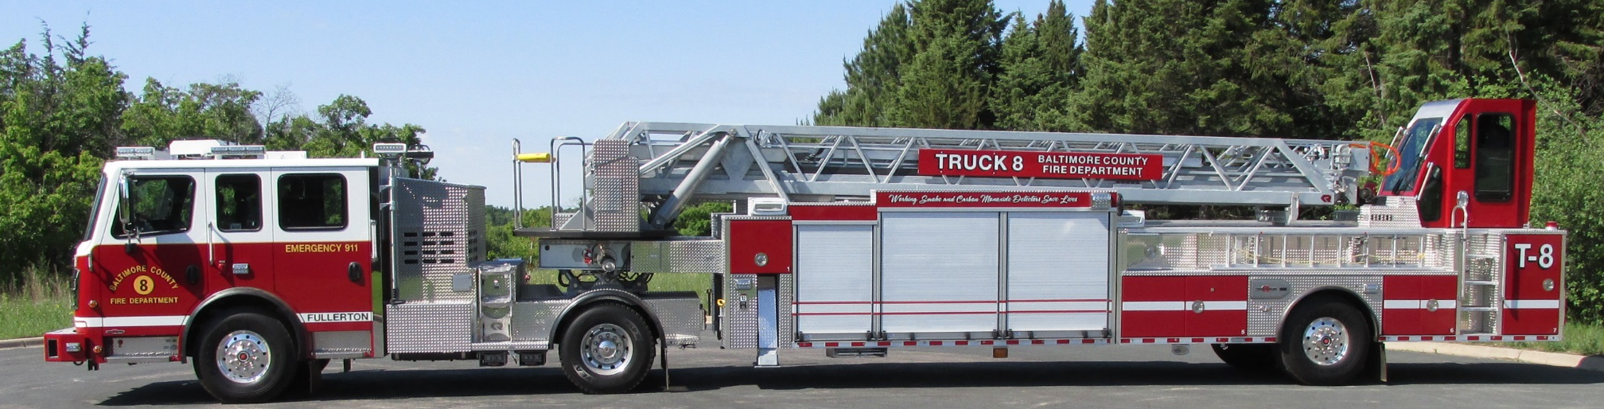
Your truck!
Rosenbauer 100’ Viper Aerial
Rosenbauer Commander chassis
Cummins ISX 500hp Engine
Onan Diesel 10kw generator

Slide 20
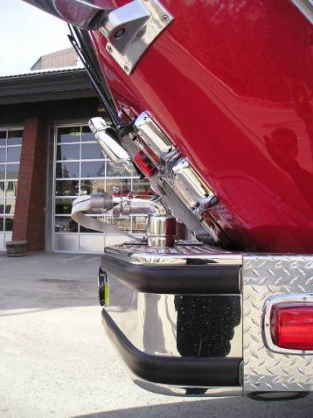
Cab Tilt Procedures
Before tilting cab check the following:
Front bumper storage lid is closed.
No equipment on front bumper.
Inside cab -all loose equipment removed such as air packs, books, portable radios, helmets, etc.

Slide 21
Shut the engine down
Leave battery switch on
Go to right side pump panel compartment
Operate switch to raise cab

Slide 22
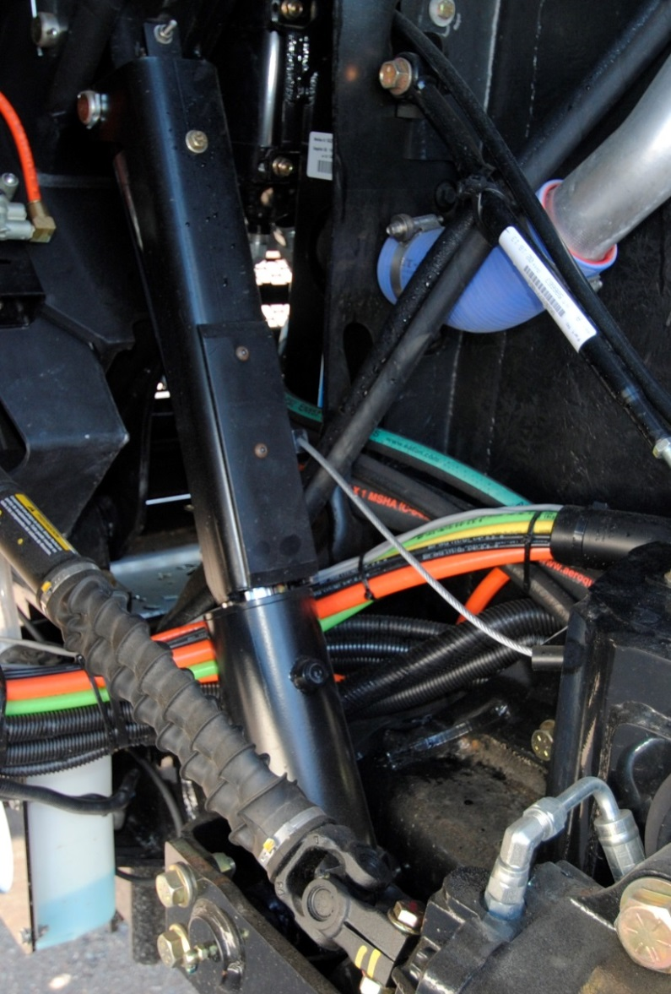
Check Safety Bar

Slide 23
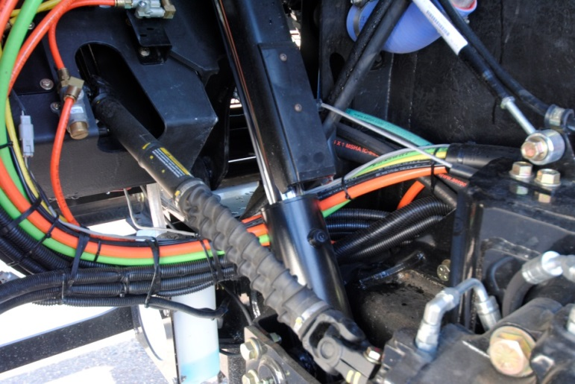
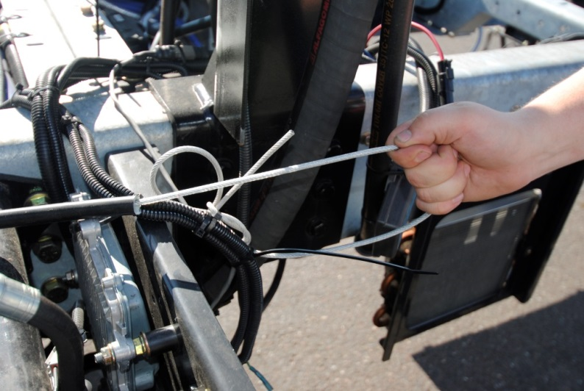
Lowering Cab
Check to see if area is clear to lower cab!
Raise cab fully
Pull cable until cab safety lock is away from the cab cylinder and hold
Hold switch down
Cab will automatically lock down

Slide 24
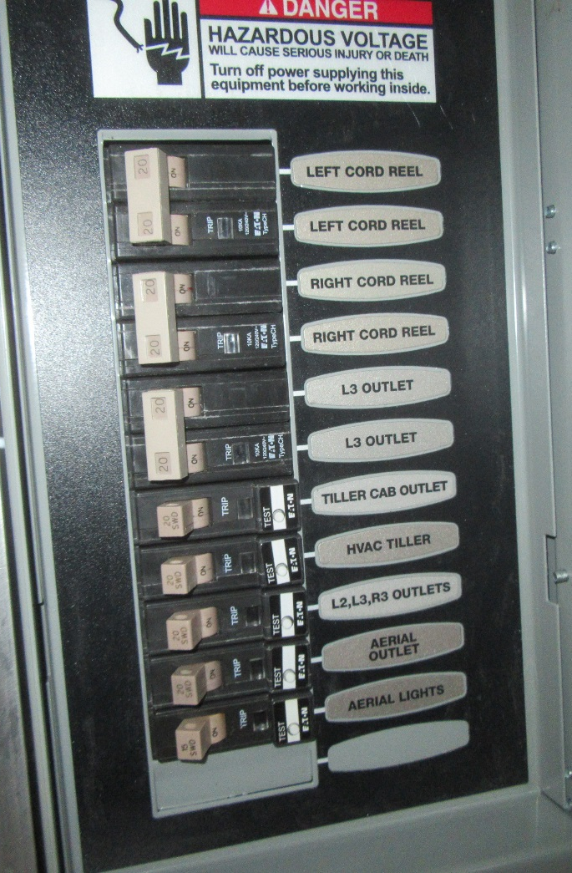
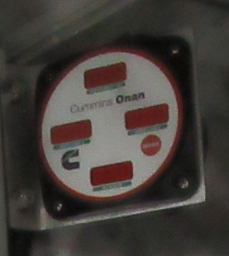
Generator Electrical Panel
Generator has a monitoring system that lets you see amps, line voltage, and frequencies.
Breaker panel box is equipped with GFI breakers.

Slide 25
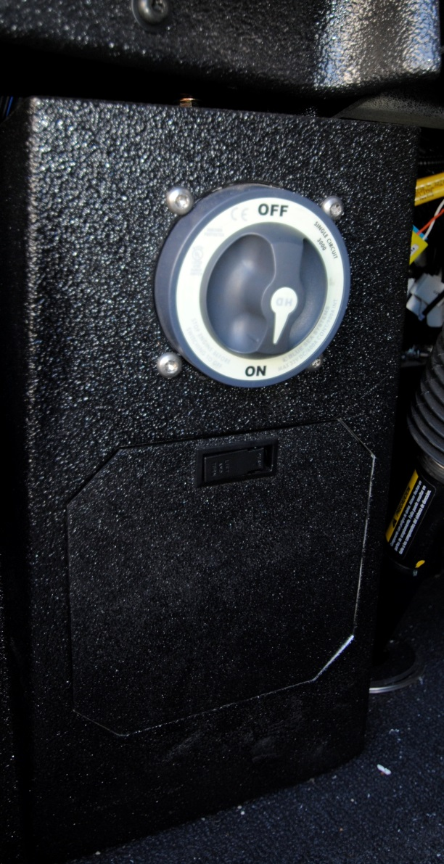
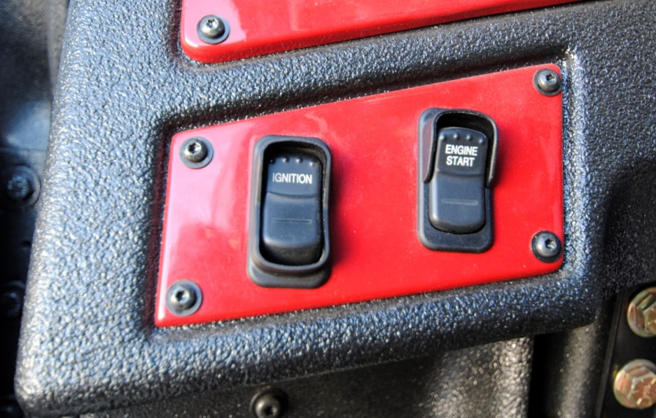
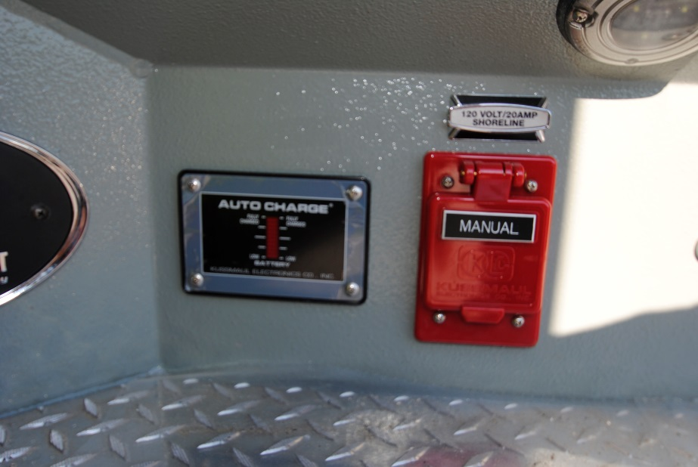

Slide 26
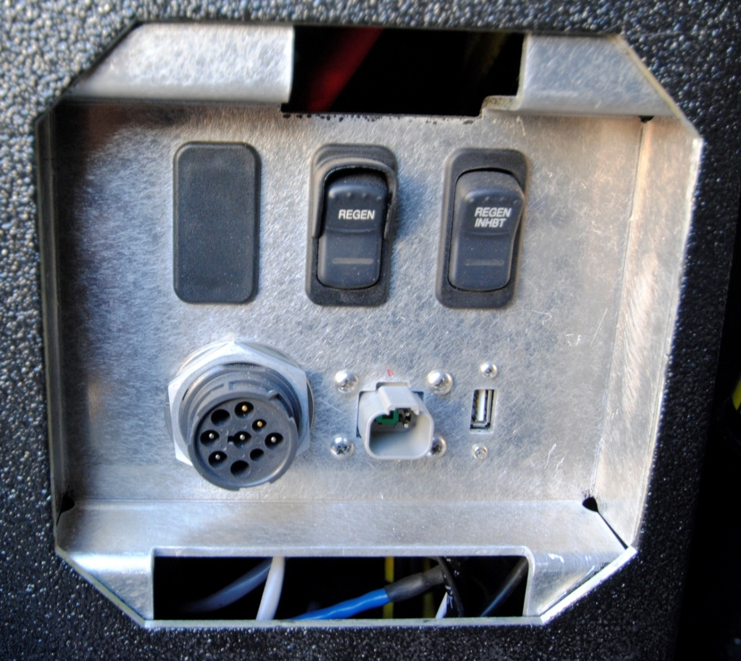

Slide 27
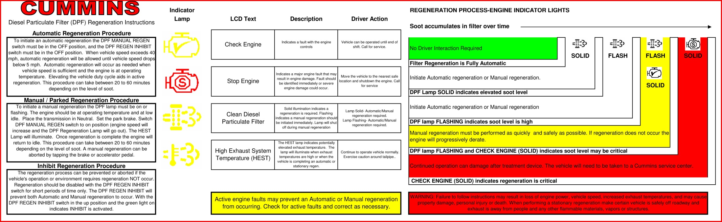
Cummins DPF

Slide 28
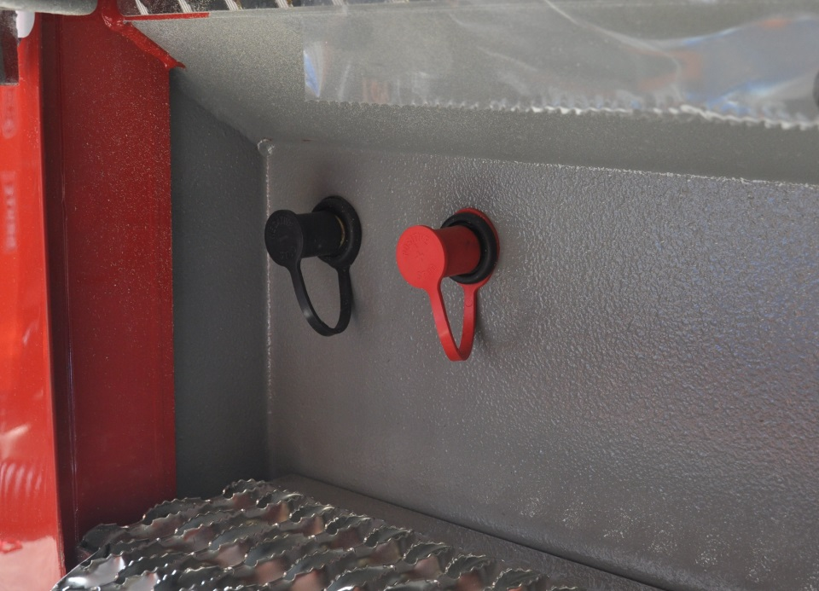
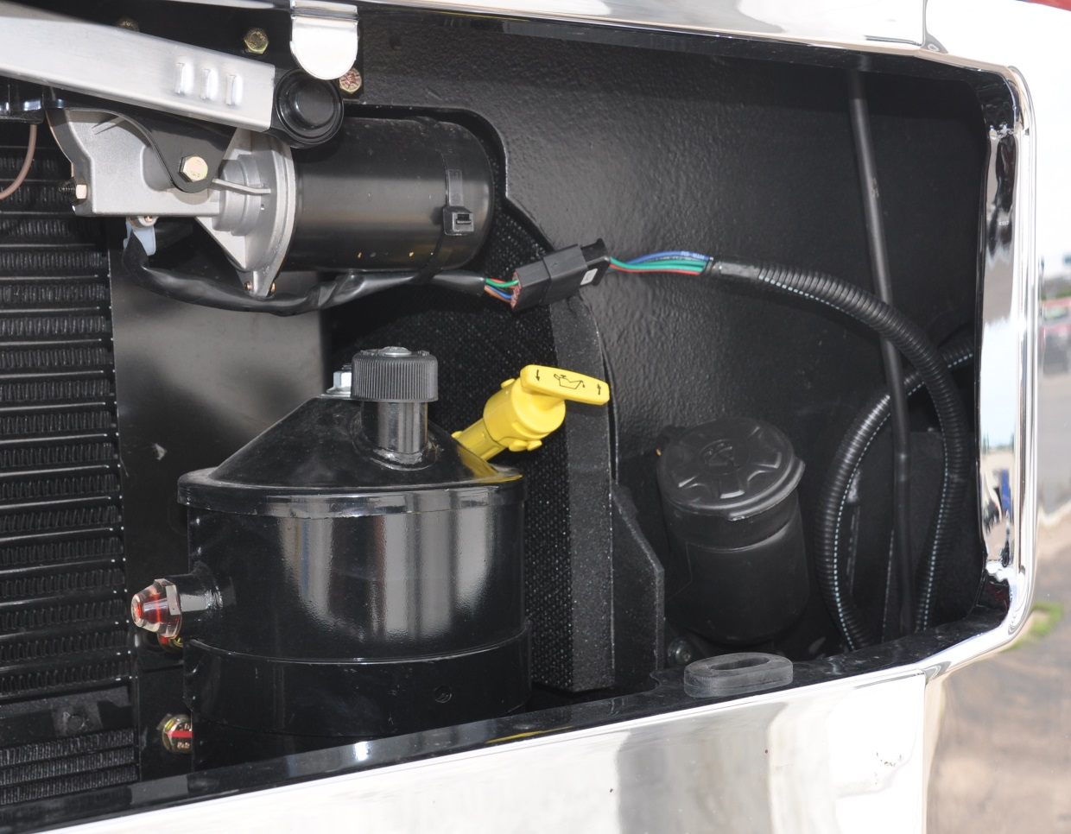

Slide 29
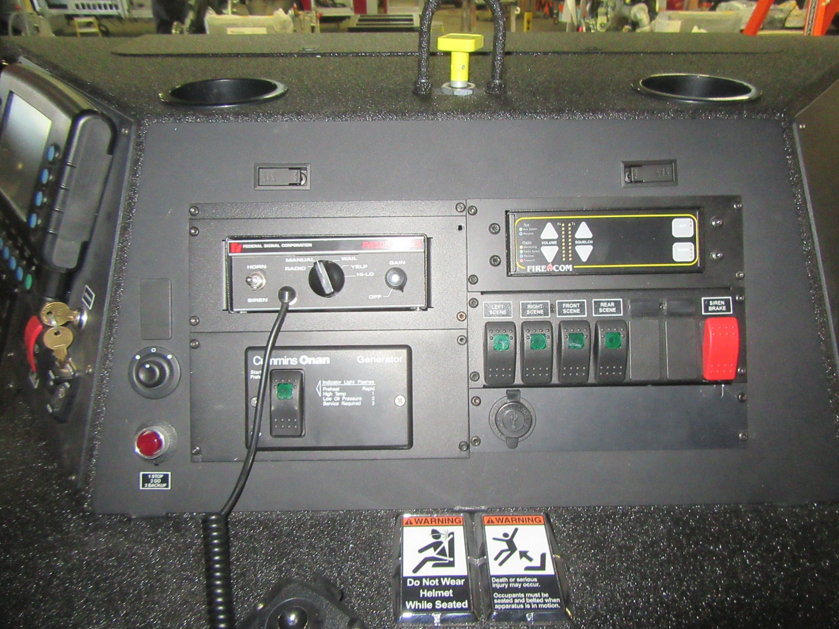

Slide 30
Aerial Technical Information

Slide 31
100’ 4-Section Tiller
2 Outriggers with a spread of 15’ 6”
Tip load dry 500 lbs.
Horizontal reach at 0° is 94’
Elevation of -10° to 75° vertical height
Axel ratings 23,000 front & 33,000 single rear
Wheel base 158”
Standard Height – 11’ 7”
Standard Length – 59’ 7”

Slide 32
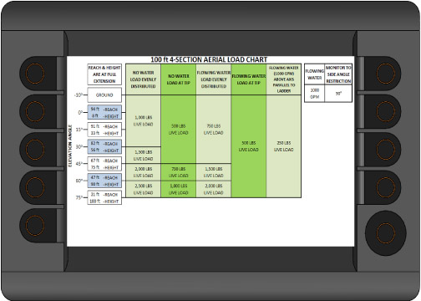
Load Chart

Slide 33
Outrigger Short Jacked
Aerial Capabilities
The Ladder Reach limits described in the table below are based on the ladder being horizontal. As the elevation angle increases, the measured section extension will increase. If the body collision protection prevents operation at less than 10°, a or reaction factor may need to be applied to the section extension measurements (*see note below table). While operating in a short jacked outrigger zone, if the ladder stops rotating and/or extending because a travel limit has been exceeded, reverse the movement until the desired function is allowed. The alarm and/or the Lower Disabled, Left Rotation, Right Rotation lights should provide an indication of what limit has been exceeded.
Model | Retracted Length (in) | Outrigger Extended 25 % - 49% |  | Outrigger Extended 50 % - 74% |  | Outrigger Extended 75 % - 95% |  | Outrigger Extended 96 % - 100%
 |  | Section Extension (in) | Ladder Reach (feet) (A) | Section Extension (in) | Ladder Reach (feet) (B) | Section Extension (in) | Ladder Reach (feet) (C) | Section Extension (in) | Ladder Reach (feet) (D)
100-4 | 385 | 52 | 45 | 72 | 50 | 92 | 55 | 248 | 94
Retracted Length is measured from the pivot pin to the egress rung or the platform outer railing.
Section Extension is measured at the lower end of the base rails, between the base section and the first moving section. This is the distance that each ladder section will extend in order to achieve the Ladder Reach. Section Extension measurements may vary by ±12 inches.
All testing is to be done with ladder near horizontal (0-5° elevation, or as low as permitted by the body collision protection system)
*For elevation angles above 10°, a correction factor should be applied to the Section Extension measurements. This is done by multiplying the measured Section Extension by the cosine of the elevation angle, thereby converting the measurement to an equivalent horizontal distance.

Slide 34
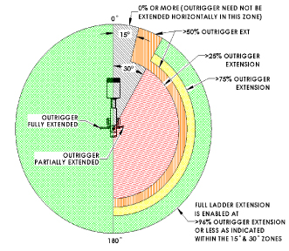
2- Outrigger Aerial Short Jacked Operating Zones
(% Values indicate outrigger extension)
Note that each operating zone is additive with those for less outrigger extension. For example, the operating zone for 50% outrigger extension is in addition to that for 25% and 0%.
Therefore boundaries between these zones will not be detected during testing at 50% outrigger
extension.

Slide 35
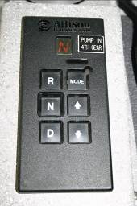
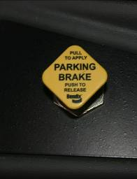
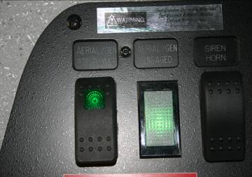
Setting Up the Cab for Aerial Operations
Shift transmission (1) from drive into neutral.
Apply the parking brake (2).
Switch on the aerial master/PTO (3). When the aerial master is switched on there is electrical power to the aerial system. At this time flashing lights on the outriggers will begin to operate.
The transmission must be in neutral (4) or 4th gear for the water pump to be engaged. The parking brake must be set before the ladder power will operate. If the water pump is engaged, the high idle of the aerial will be disengaged.
4
2
1
3

Slide 36
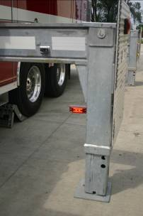
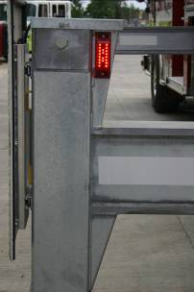
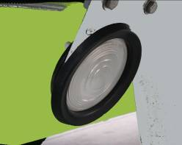
Outrigger Operation Set Up
Once the ladder power is activated, the flashing light (1) on the inside of the outrigger jack tubes will begin to flash and the outrigger jack scene lights (2) will come on.
Outriggers are ready to operate.
1
1
2

Slide 37
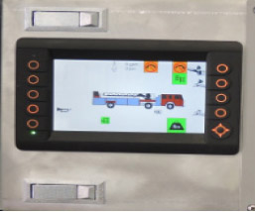
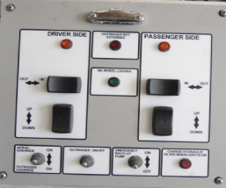
Outrigger Operation Set Up
With tire chocks set the operator will proceed to the outrigger station. The Outrigger Not Extended Light will be illuminated. This light will stay illuminated until all outriggers have been fully extended and are making contact with the ground.
Move Outrigger On/Off Switch to the ON position
This will cause the high idle to engage and the warning alarm will begin. The alarm alerts all other personnel the outriggers are being positioned. If the water pump is engaged the high idle of the aerial will be disengaged.

Slide 38
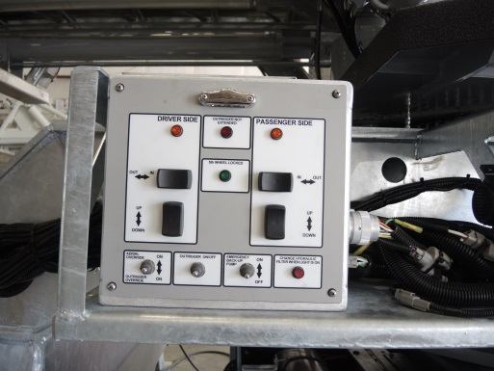
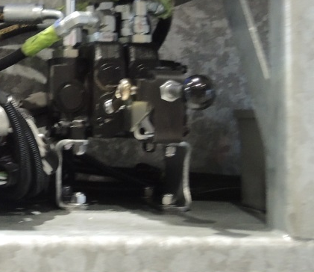
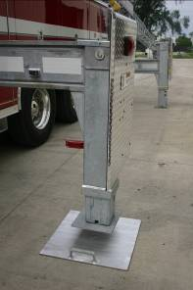
Outrigger Operation Set Up
Use Controllers to Extend Outriggers.
The outrigger controls are located to the back, outside of the truck to provide the operator a good clear vision to set up the outriggers.
The controllers are designed to move in the same direction as the corresponding outrigger. (Example: To extend the right outrigger you would push the controller to the right to extend and to the left to retract.)
Position outrigger pads under jack locations

Slide 39
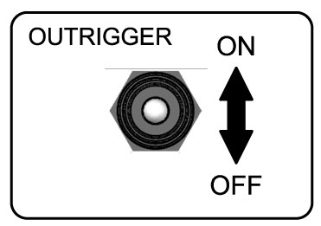
Outrigger Control Panel
Outrigger On/Off Switch
The Outrigger On/Off Switch must be turned on before the outriggers can be operated. This will enable the high idle if water pump is not engaged.

Slide 40
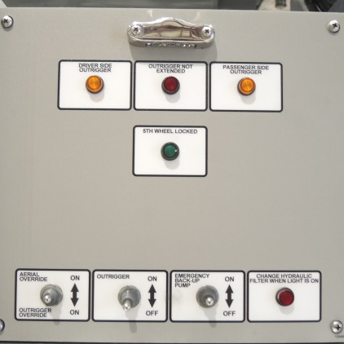
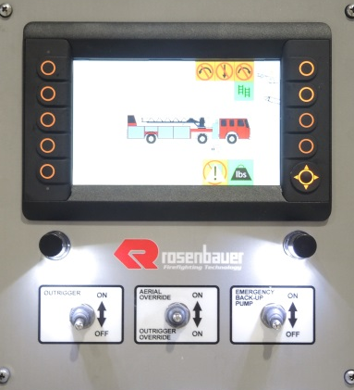
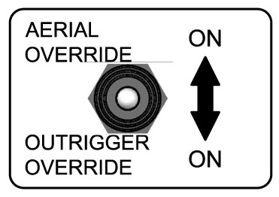
Outrigger Control Panel
Aerial/Outrigger Override Switch
With the aerial out of the bed, the outriggers can no longer be operated. If a case arises where the outriggers need to be readjusted, activate the momentary Aerial/Outrigger Override Switch down to Outrigger Override. Adjust the outrigger controls (left/right, up/down) until the outrigger is set to the desired place.
If a case arises where the aerial needs to be overridden, activate the momentary Aerial/Outrigger Override Switch up to Aerial Override. A second operator will then need to adjust the aerial to the desired location using the manual aerial controls (extend/retract, left/right, raise/lower). Extreme caution must be taken when using the overrides.

Slide 41
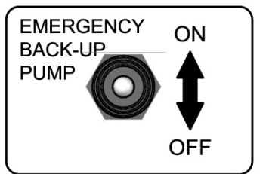
Outrigger Control Panel
Emergency Back-Up Pump On/Off Switch
The sole purpose of the Emergency Back-Up Pump is to stow the aerial in case of hydraulic failure.
  To Use Emergency Back-Up Pump
  Select the operation required (outrigger or aerial) and move switch to the on position.
  Engage the outrigger or aerial control handle.
  Activate momentarily the Emergency 12V Back-Up Pump
  To ensure that the Emergency Back-Up Pump doesn’t over heat, it can only operate 5 minutes out of 60.

Slide 42
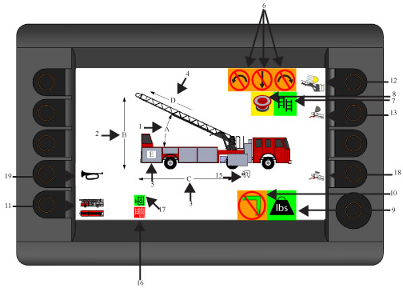
Aerial Control Panel
AERIAL SMART SCREEN DISPLAY
Aerial Elevation (A)
Aerial Height (B)
Aerial Reach (C)
Aerial Extension Remaining (D)
Aerial Rotation (E)
Operational Envelop Indicators
Rung Alignment Indicator
Emergency Stop Indicator
Aerial Load Gauge
Outrigger Not Extended Indicator
Auto Bedding Indicator
Breathing Air
Tracking Lights Button
Tip Lights Button
5th Wheel Lock
Dirty Filter Indicator
Hydraulic Tank Level Indicator
Tip Marker Lights
Air Horn

Slide 43
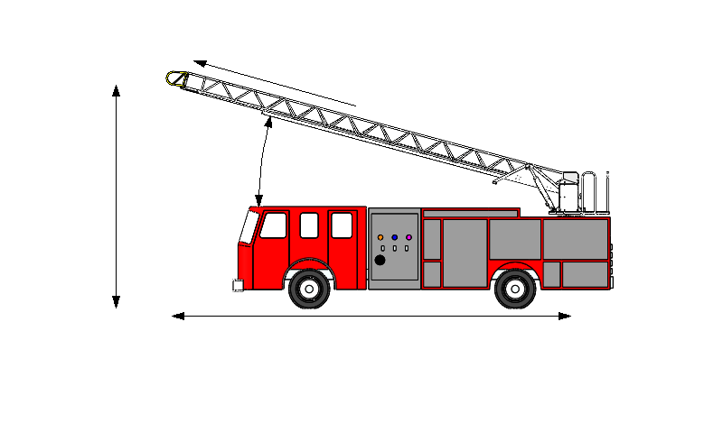
Aerial Control Panel
Aerial Elevation (A):
The “A” displays the aerial elevation in degrees
Aerial Height (B):
  The “B” displays the height of the aerial.
Aerial Reach (C):
  The “C” displays the reach of the aerial.
Aerial Extension Remaining (D):
  The “D” displays the extension remaining.
Aerial Rotation (E)
  The “E” displays rotation angle. Left of the ladder bed is negative numbers and right of the ladder bed is positive number.
D
A
B
E
C

Slide 44



Aerial Control Panel
Operational Envelops Indicators:
Indicators (left disabled, down disabled & right disabled) will illuminate when their respective function of the aerial has been disabled. Should the aerial enter an overload situation the down disable and right and/or left disable light will illuminate indicating the aerial will need to be retracted and raised in order to continue operations. If the aerial is lowered at a pre programmed position over the cab or body the aerial will come to a smooth stop and the down disabled light will illuminate. If right or left rotation light is on, the aerial is restricted from operating in that direction. With the ladder in the bedded position both left and right disabled indicators will appear and the down disabled indicator will not.

Slide 45


Aerial Control Panel
Rung Alignment Indicator:
The rung alignment indicator will illuminate when the rungs are aligned. While extending or retracting the aerial this indicator will flash on and off in accordance with the rungs being aligned. It is recommended that the rungs be aligned when personnel are climbing the aerial for personal safety.
Emergency Stop Switch:
Should the operator come into a dangerous situation and need to stop the aerial immediately push down on the emergency stop button at the control station and the aerial will come to an immediate stop. The operator will need to pull up on the emergency stop button in order to reactive the aerial operation controls. When the emergency stop is engaged an indicator will appear on the screen indicating so.

Slide 46




Aerial Control Panel
Aerial Load Monitor:
The screen will continually indicate the state of the load on the aerial.
  The green indicator states that the load is within load limits.
  The yellow indicator states caution, alerting the operator that the load is getting closer to overload
  The red indicator states overload when the rated load capacity is approximately 100 less then the rated live load.
  The red indicator will flash between the red and the red with the yellow cautionary symbol over it when the rated capacity is exceeded by more then 100 pounds of the rated live load. A horn will also emit at this time.

Slide 47


Aerial Control Panel
Outrigger Not Extended Indicator:
The outrigger not extended indicator will be illuminated if any outrigger is short set of doesn’t have solid contact with the ground.
  When any outrigger is preventing the aerial from moving the outrigger not extended indicator will flash with the cautionary symbol.

Slide 48


Aerial Control Panel
Auto Bedding Switch & Indicator:
When auto bedding icon indicator is displayed auto bedding is enabled. The auto bedding indicator will be moving display on the screen picturing the ladder in the ready to bed state and then bedded. The auto bedding switch is a momentary switch. The aerial needs to be approximately 20% extended, 20 degrees to the right or left of the ladder bed and below 20 degrees elevated. Activate on the momentary auto bedding switch and the aerial will automatically bed itself. If the switch is released the aerial will stop moving.

Slide 49
Aerial Control Panel
Tracking Lights Switch:
To activate the tracking lights, (lights located on the base section in front of the elevation cylinders) the button will need to be pushed to activate the lights on and off. This button will activate all AC and DC tracking lights as well as the panel lights and operational rung lighting.
  The indicator on the screen will display a grey light when lights are off. The indicator on the screen will display yellow when the lights are activated. Most AC and DC light provided also include a switch on the lamp head itself. If personnel switched the switch on the lamp head to the off position the operator will not be able to override it from the control panel. The switch will need to be reengaged from the lamp head.

Slide 50
Aerial Control Panel
Tip Lights Switch:
To activate the tip lights, (lights located on the front of the aerial) the button will need to be pushed to activate the lights on and off. This button will activate all AC and DC tip lights.
  The indicator on the screen will display a grey light when lights are off. The indicator on the screen will display yellow when the lights are activated. Most AC and DC light provided also include a switch on the lamp head itself. If personnel switched the switch on the lamp head to the off position the operator will not be able to override it from the control panel. The switch will need to be reengaged from the lamp head.

Slide 51
Aerial Control Panel
5th Wheel Lock:
The 5th wheel lock will engage and disengage automatically depending on the position of the outriggers. When the outrigger on/off switch is in the on position the outrigger are able to be adjusted and the indicator will show the 5th wheel as unlocked. Once the outriggers are fully set and the outrigger on/off switch is put into the off position the 5th wheel will automatically lock and the indicator will show as locked. The indicator will appear on both the main information page and on the outrigger screen.

Slide 52

Aerial Control Panel
^{16. Dirty Filter Indicator}
The dirty filter indicator is to alert the operator that one or more of the aerial filters (high pressure, return filter) are dirty and need to be changed. It is recommended that when the indicator appears all filters be changed. The filter will only appear on the screen when there is a dirty filter.

Slide 53



Aerial Control Panel
17. Hydraulic Tank Level Indicator
These icons will let you know if the hydraulic oil in your reservoir is getting low. The green hydraulic oil tank level icon is displayed when the tank level is full (within 5 gallons from full mark on dipstick). The amber hydraulic oil tank level icon is displayed when the tank is OK to operate (from 5 gallons below full, to 5 gallons above primary suction line). The red hydraulic oil tank level icon is displayed when the tank is critically low (less than 5 gallons above primary suction line).

Slide 54
Aerial Control Panel
^{18. Tip Marker Lights}
The tip marker lights are located on the tip of the aerial the help the operator and ground personal better identify where the tip of the aerial is. Push the button and the lights will activate and the icon will illuminate to green. Push the button again and the lights will turn off and the icon will become gray.

Slide 55
Aerial Control Panel
^{19. Air Horn}
The air horn switch is a momentary switch. Push the button and the horn will emit and the icon on the screen will turn green. Release the button and the horn will stop and the icon will turn to black.

Slide 56
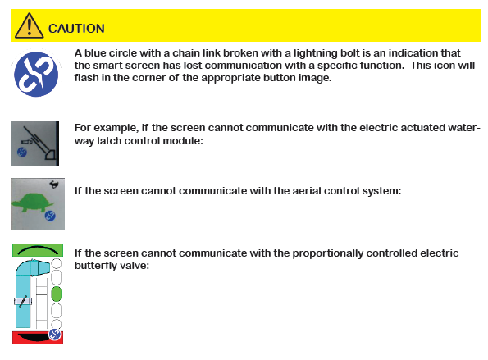

Slide 57
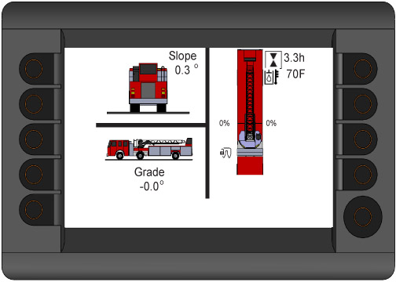
Aerial Control Panel
AERIAL SMART SCREEN DISPLAY
Side to Side Slope
Front to Back Slope
Outrigger Configuration
Aerial Hour Meter
5th Wheel Lock

Slide 58
Aerial Control Panel
Side to Side Slope:
The top portion of the screen displays side to side leveling of the truck. As the outriggers are set the slop will change, in degrees, to indicate how level the truck is side to side. It is highly recommended the truck be set within five degrees to the left or right.
Slope
0.3°

Slide 59
Aerial Control Panel
Front to Back Slope:
The bottom portion of the screen displays front to back leveling of the truck. As the outriggers are set the slop will change, in degrees, to indicate how level the truck is side to side. It is highly recommended the truck be set within five degrees to the left or right.
Grade
-0.0°
Outrigger Configuration:
The outrigger configuration on the left side of the screen indicates the configuration of each individual outrigger in percentage. As each outrigger is extended the percentage will change until it reaches 100% or the desired extension. Depending on how far the outrigger is extended will determine the color it will appear in on the screen. The color will coordinate with the outrigger cordierites of operation on the pie and load charts.
0%
0%
8

Slide 60
Aerial Control Panel
Aerial Hour Meter:
The aerial hour meter will track the hours the aerial has been operated.
3.3
5th Wheel Lock:
The 5th wheel lock will engage and disengage automatically depending on the position of the outriggers. When the outrigger on/off switch is in the on position the outrigger are able to be adjusted and the indicator will show the 5th wheel as unlocked. Once the outriggers are fully set and the outrigger on/off switch is put into the off position the 5th wheel will automatically lock and the indicator will show as locked. The indicator will appear on both the main information page and on the outrigger screen.
0%
0%
8

Slide 61
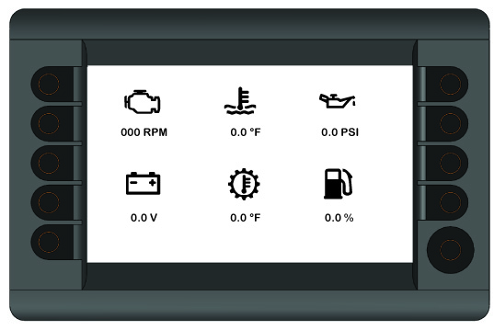
Aerial Control Panel
AERIAL ENGINE DIAGNOSTICS SCREEN DISPLAY THREE
Engine RPM
Engine Coolant Temperate
Engine Oil Pressure
Battery Charging Condition
Transmission Fluid Temperature
Fuel Level

Slide 62
Aerial Control Panel
Engine RPM:
This indicator shows the current engine RPM’s
Engine Coolant Temperature:
This indicator shows the engine coolant temperature.
Engine Oil Pressure:
This indicator shows the engine oil pressure.
Battery Charging Condition:
This indicator shows charged the battery is.
Transmission Fluid Temperature:
This indicator shows the transmission fluid temperature.
Fuel Level:
This indicator shows how much fuel is in the truck.

Slide 63
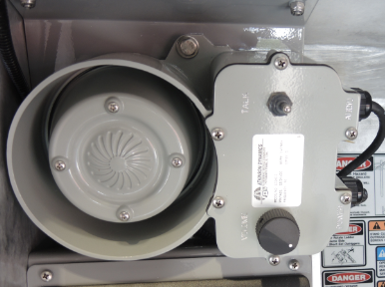
Aerial Intercom

Slide 64
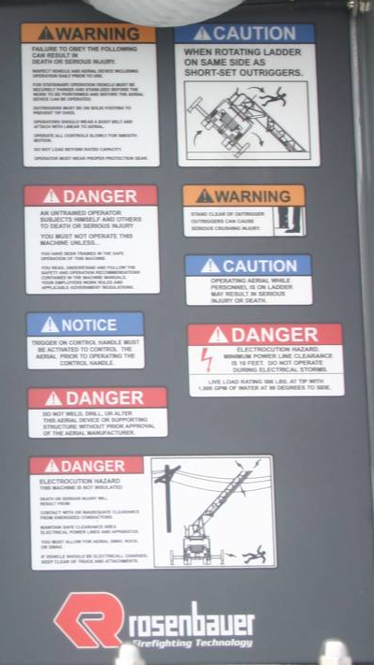
Aerial Warnings
Warning Labels
The warning labels are located in the lid and will warn the operator of potential life threatening situations that could occur when operating the aerial.

Slide 65
Water Flow
1 ways to use your aerial to flow water
  From external source to Aerial Device

Slide 66
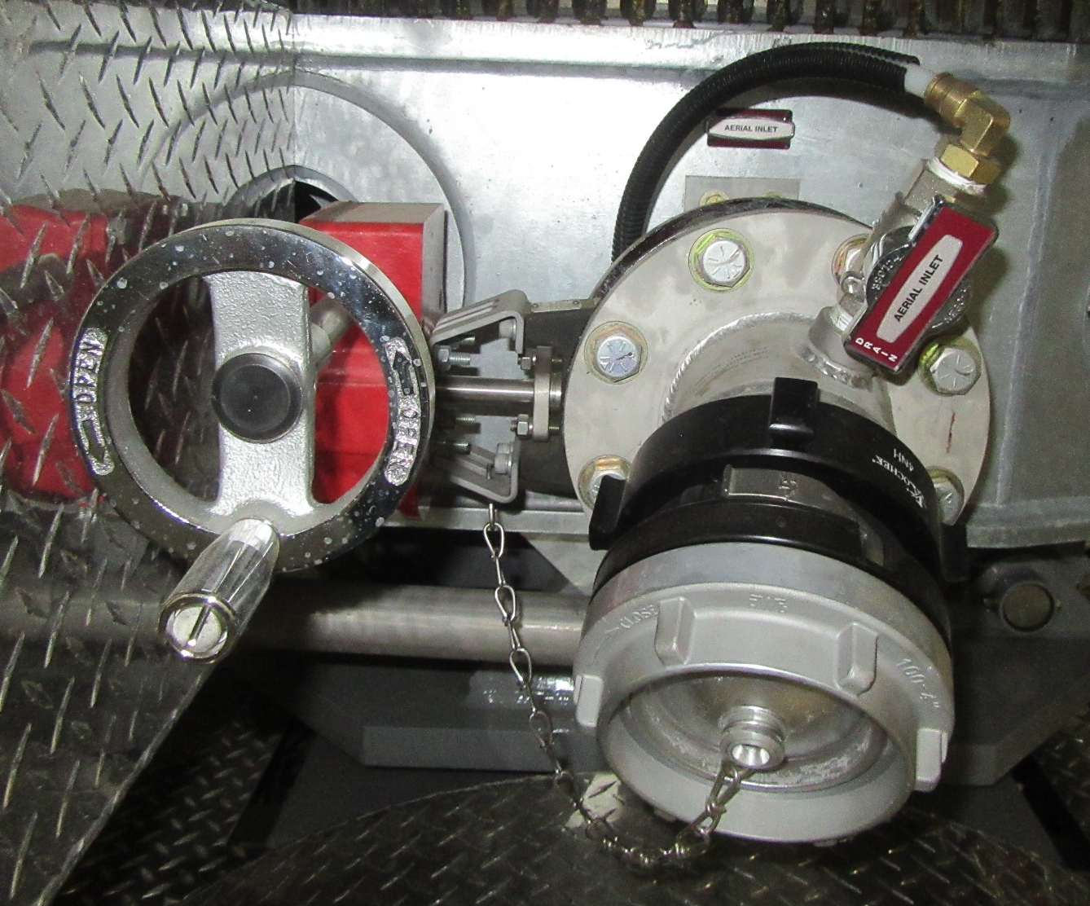
Water Flow From Relay
To discharge water from relay operations through the aerial device:

Slide 67
Overview
Practical operations of aerial to include:
Positioning of the truck
Outrigger operation, placement and setup
Operation of the aerial from the turn table
Operation of the aerial from the remote control
Moving water

Slide 68
QUESTIONS?

